Slide 1
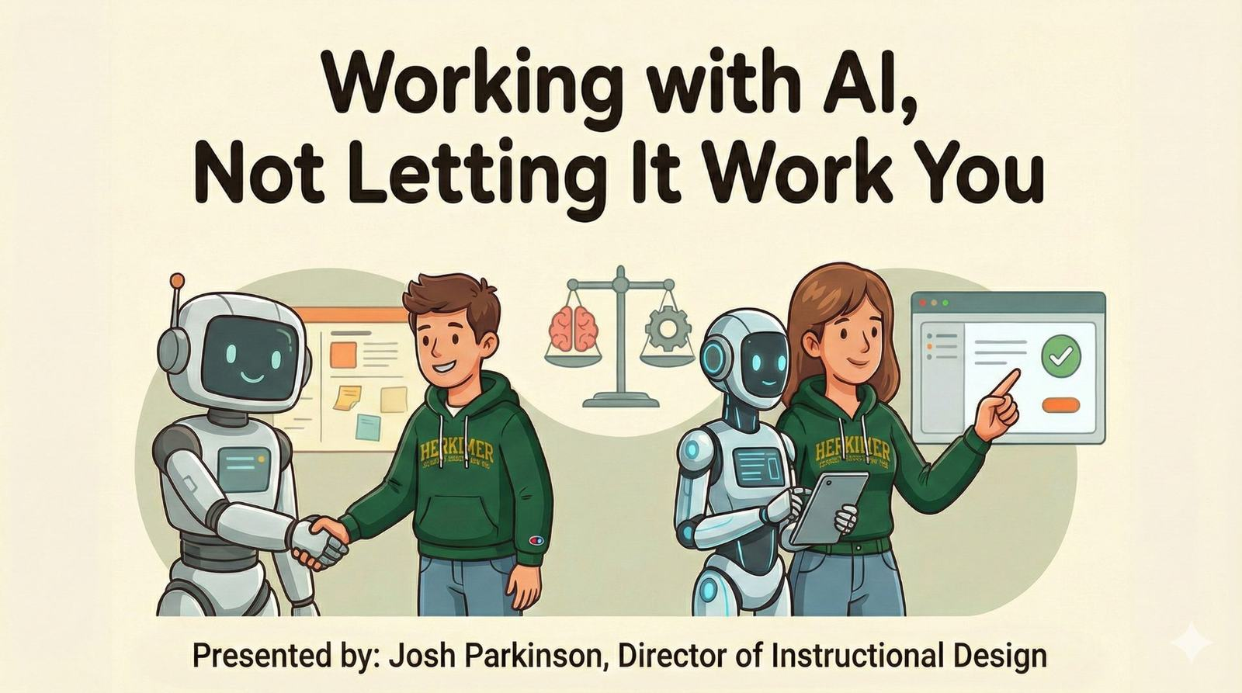

Slide 2
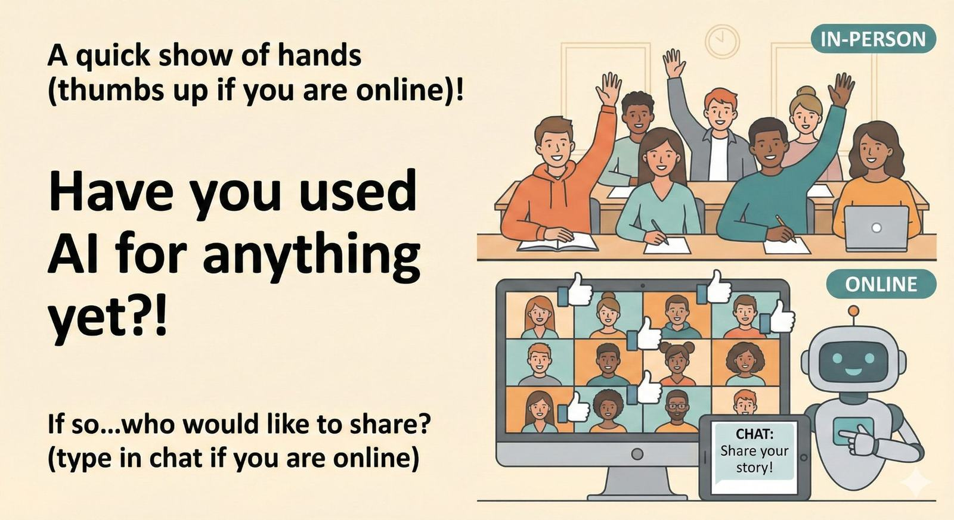
Notes:
Pull 2–3 quick examples.
Bucket answers: school, work, personal.
Set tone: no judgment, we’re building skills.

Slide 3
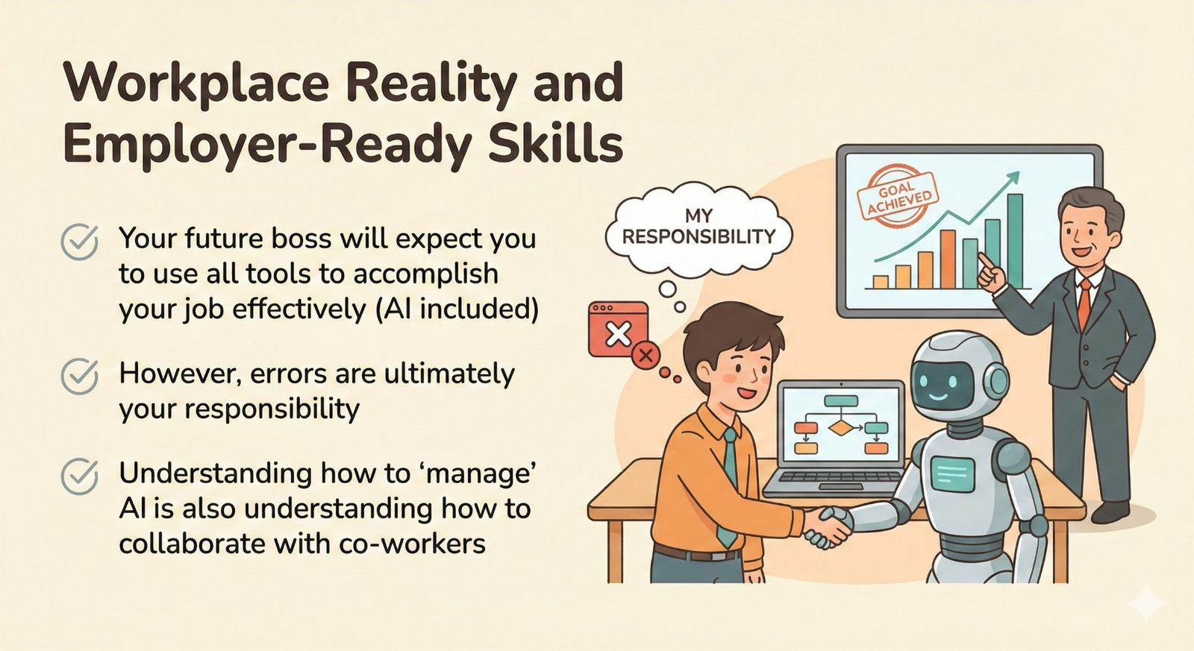
Notes:
Pull the key employer framing: employers want people who can manage AI, not just use it.
Add your note: speed is king, but accuracy keeps your job.

Slide 4
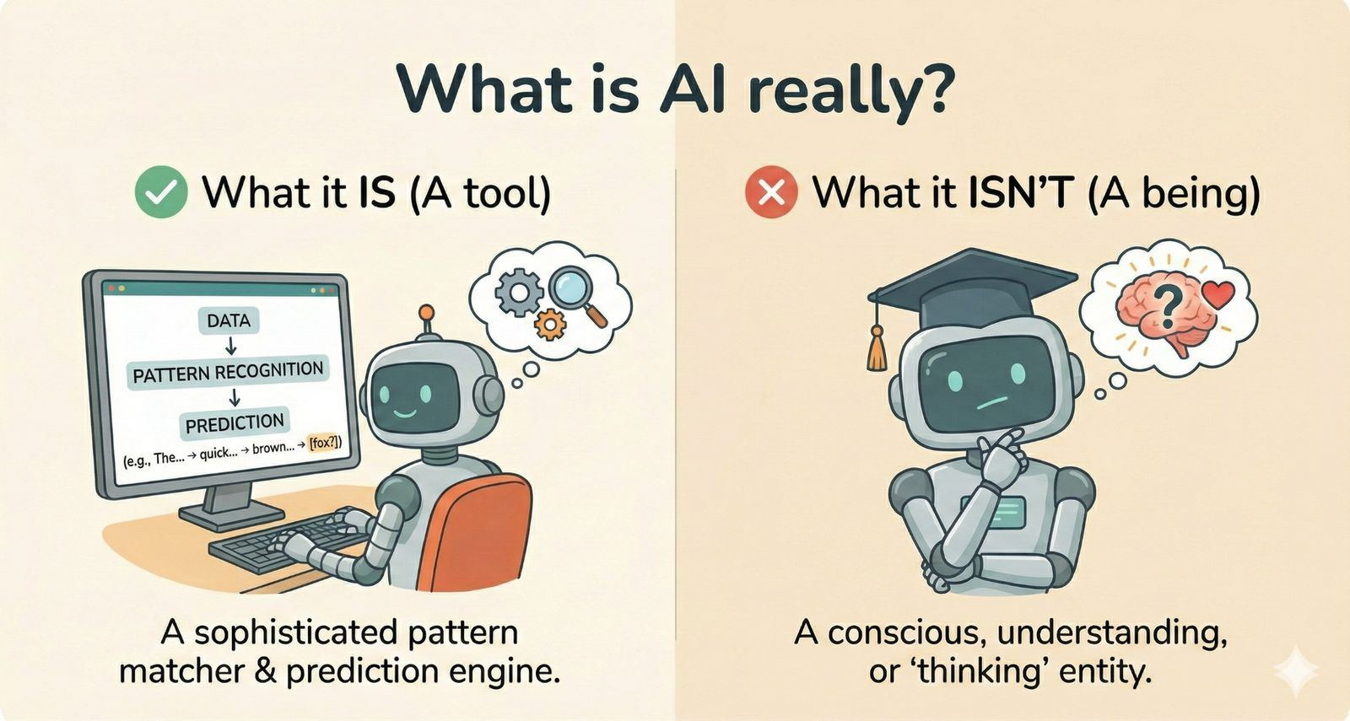

Slide 5
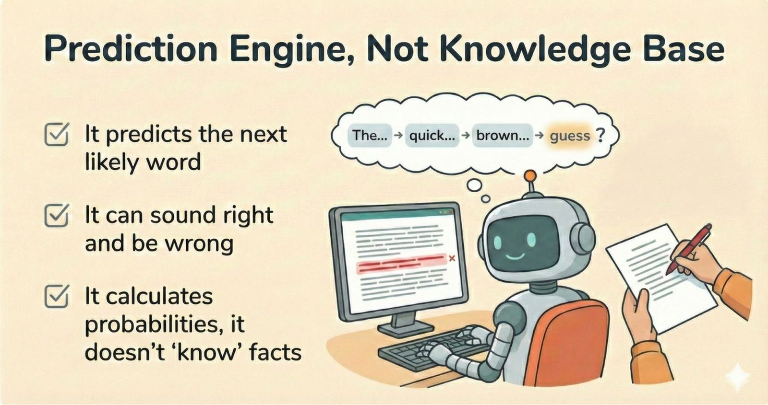
Notes:
This is where you define hallucinations in plain language.
Line to land: “It’s highly literate and sometimes overconfident.”

Slide 6
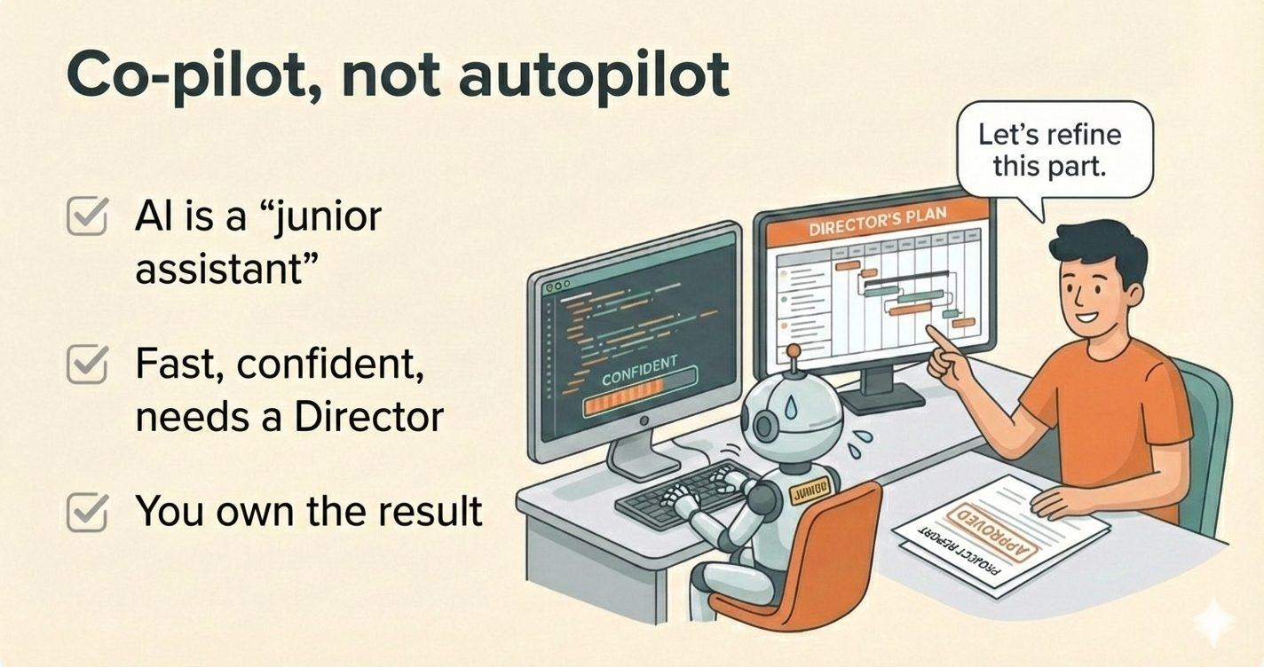
Notes:
Bring in your “intern” analogy from the PDF and your notes.
Working with AI
Optional quick story: “finishing people’s sentences” as the prediction idea (your funny aside).

Slide 7
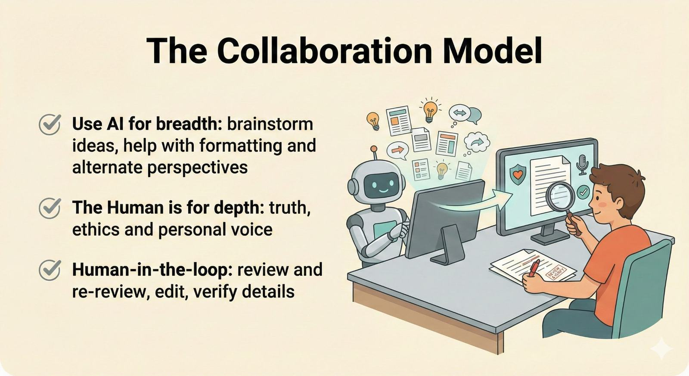

Slide 8
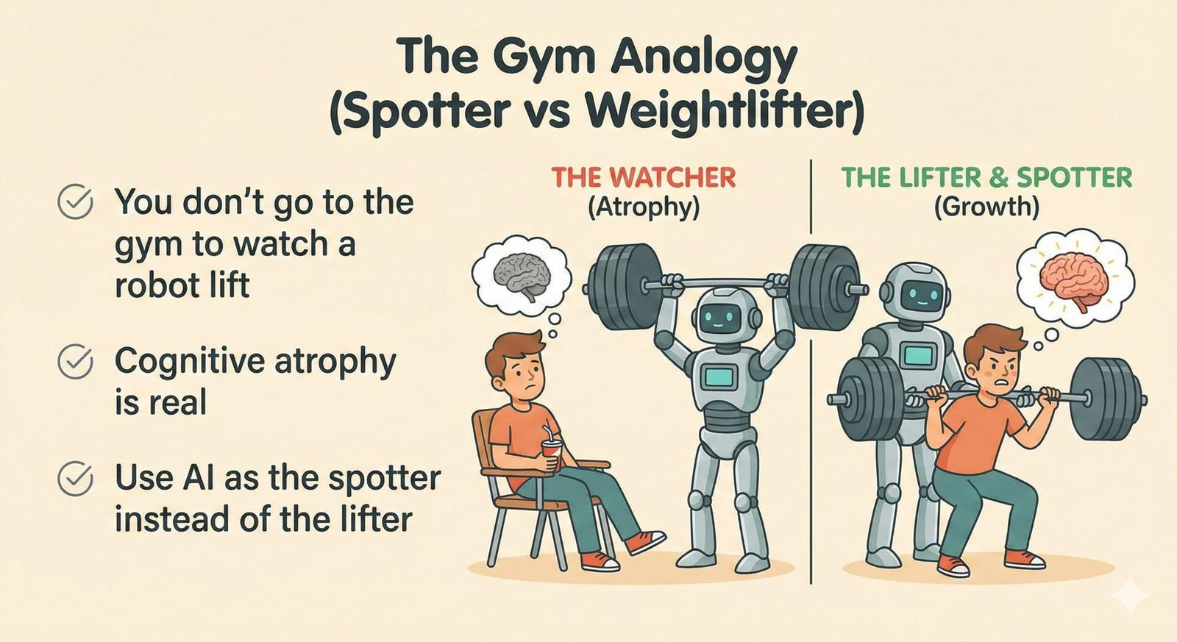
Notes:
Make it concrete:
Spotter = helps you practice, checks form, gives feedback
Robot lifter = you get weaker
Tie directly to your threshold idea: if AI is doing synthesis, AI is doing learning.

Slide 9
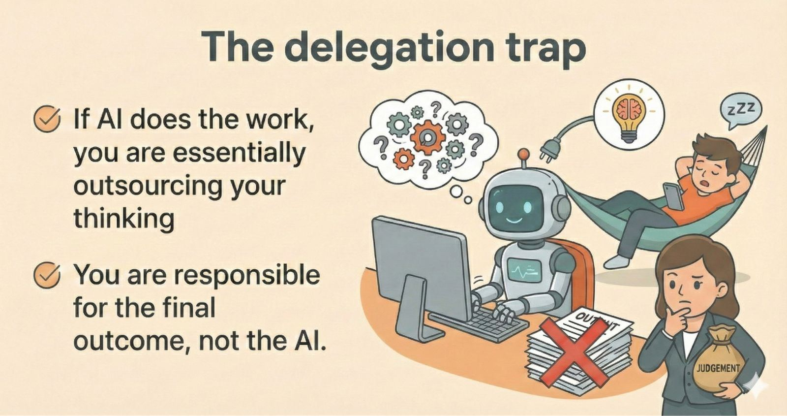
Notes:
“Human-in-the-loop” simple definition: you review, edit, verify, and can explain it.
Working with AI
Make it real: “If you cannot explain it, you didn’t learn it.”

Slide 10
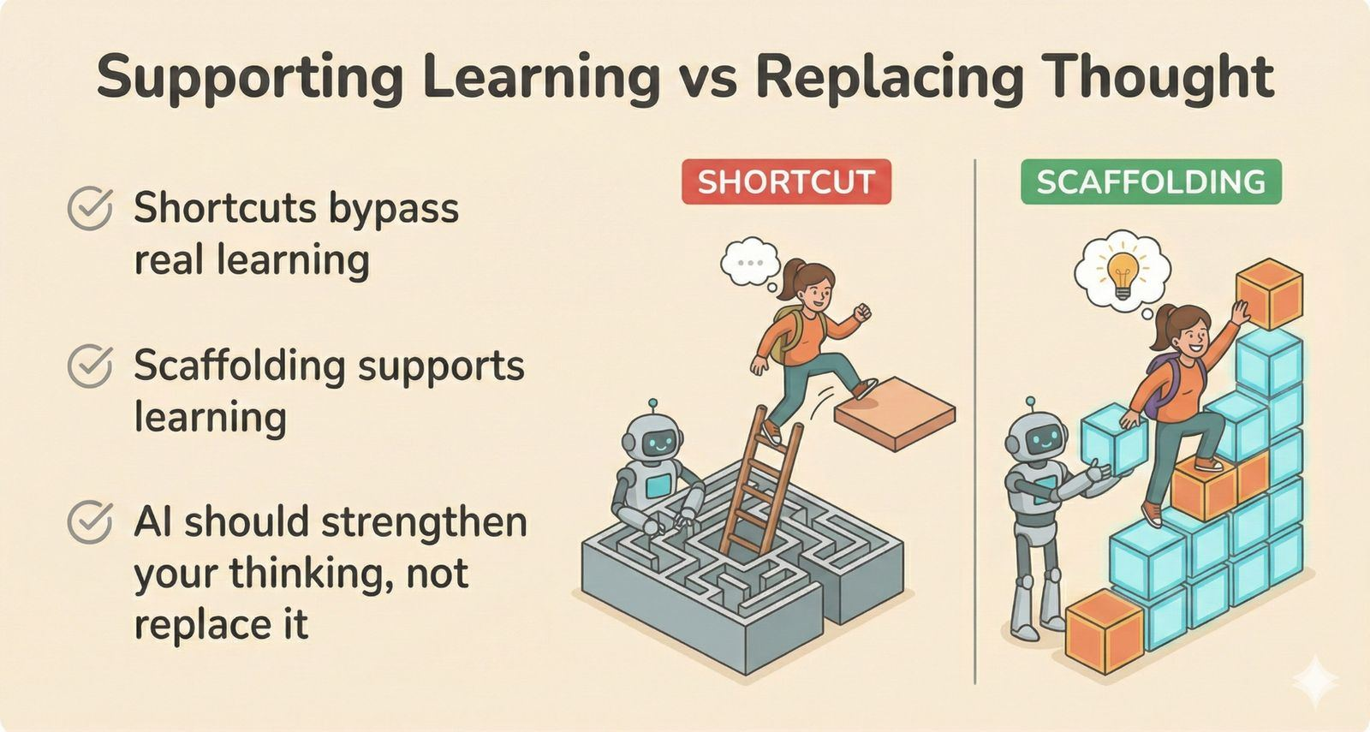
Notes:
Set up the “gym” analogy, which is in your PDF and aligns with your slide 3 notes.

Slide 11
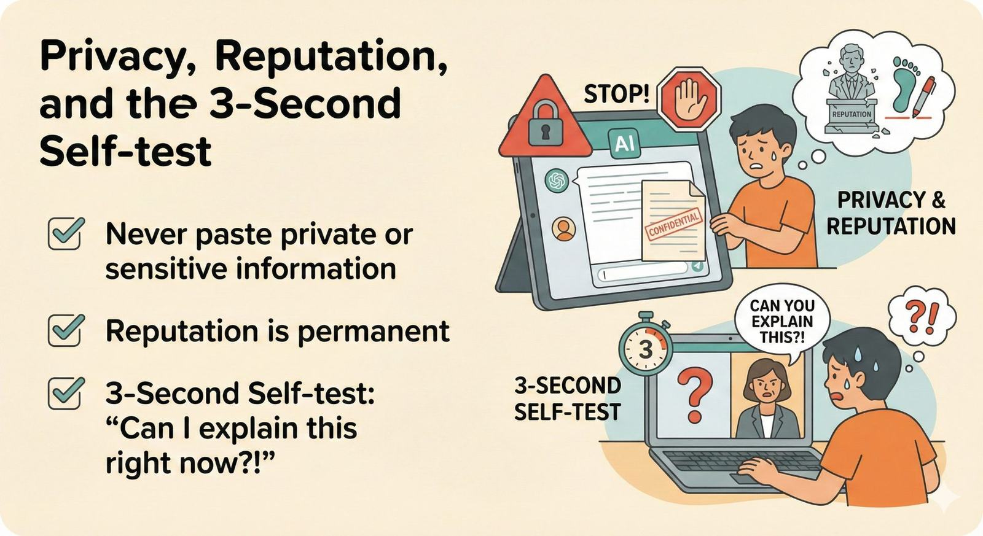
Notes:
Use your “permanent record” framing from your notes and the privacy hazard from the PDF.
Strong close: “Be the Director. Make AI your tool, not your crutch.”

Slide 12
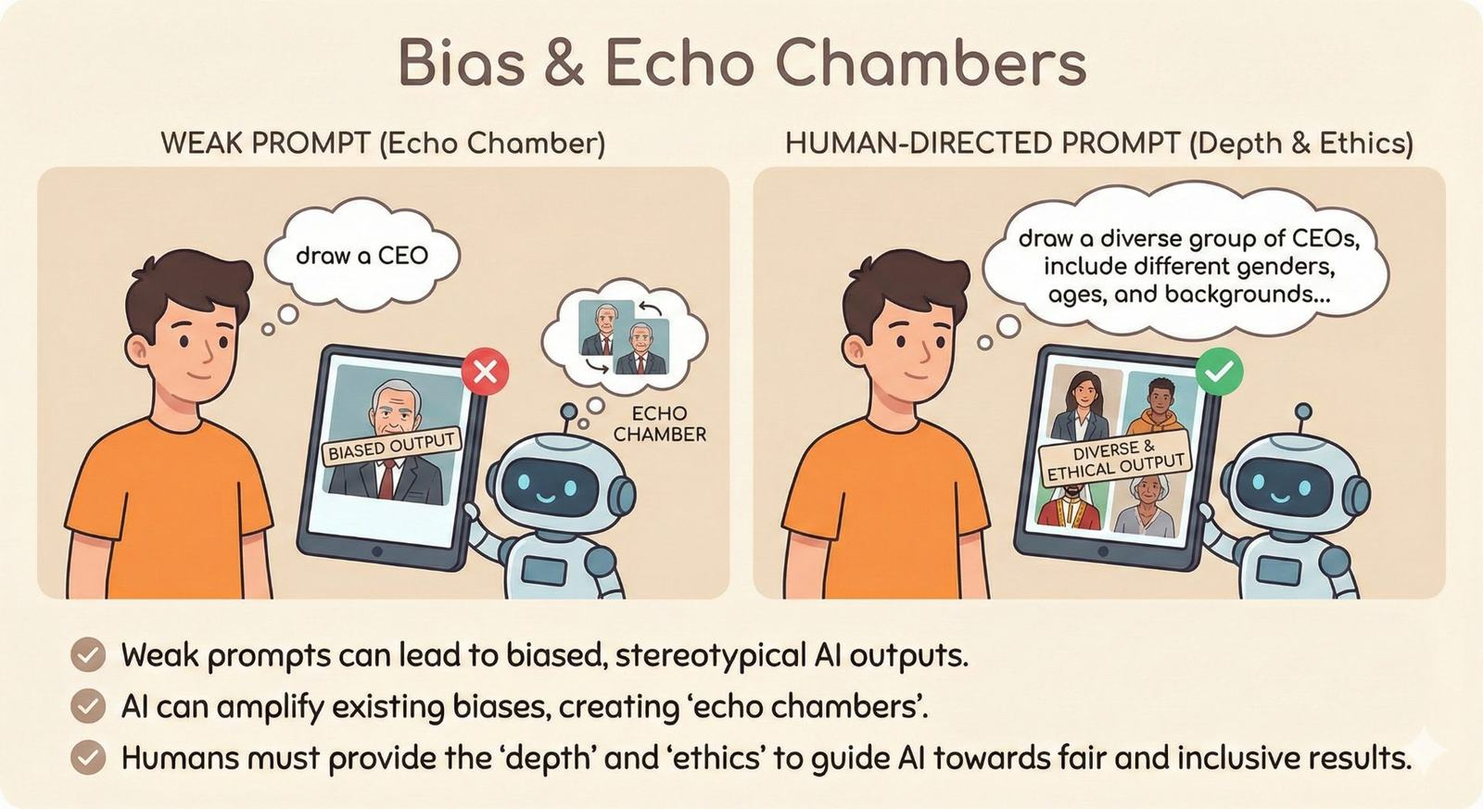

Slide 13
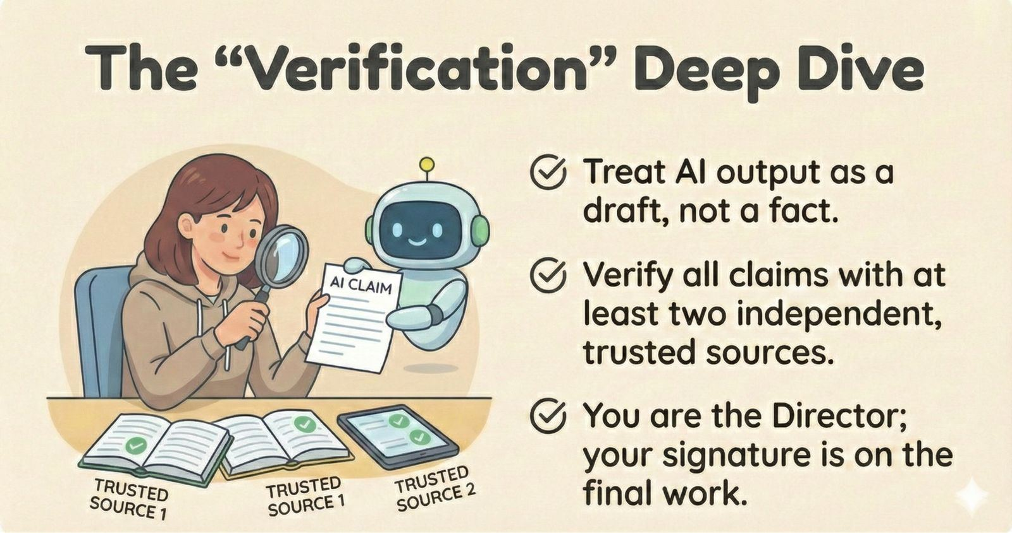

Slide 14
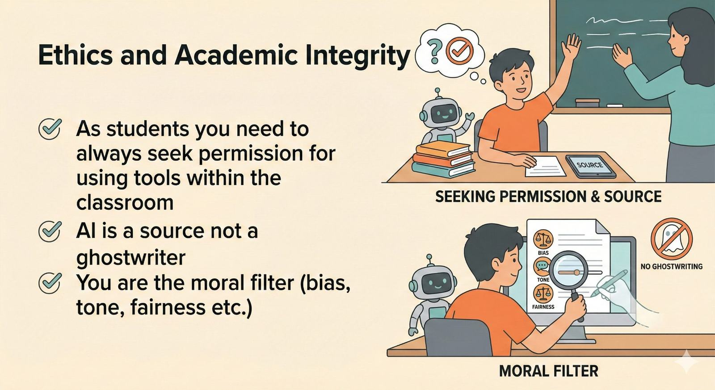
Notes:
Drop your “fastest way to an academic conduct meeting” line.
Mention bias plainly: trained on the internet, inherits internet’s baggage.

Slide 15
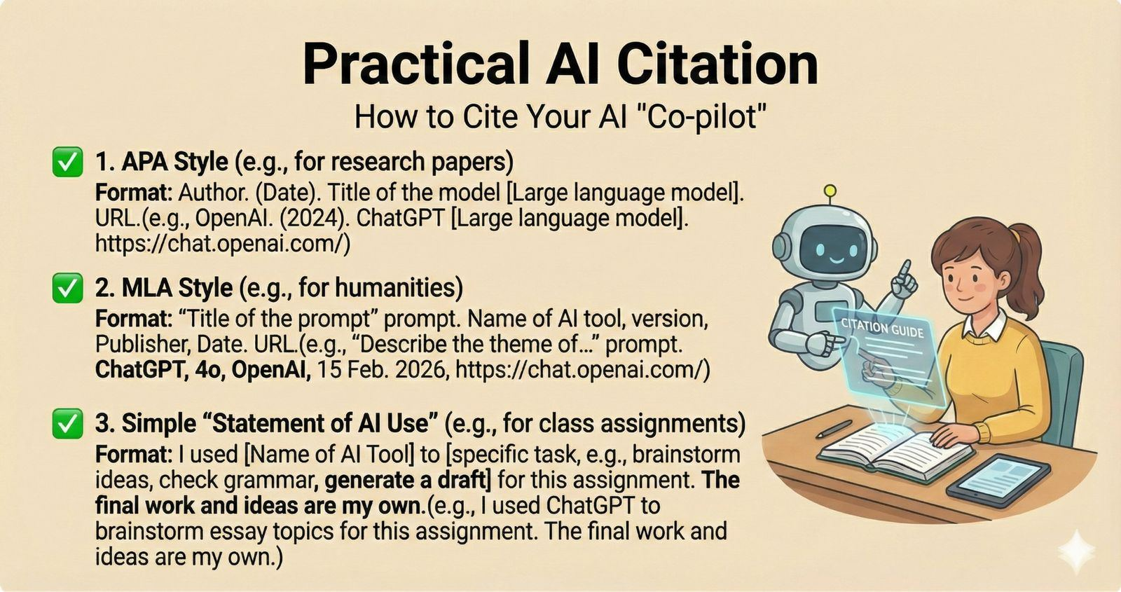

Slide 16
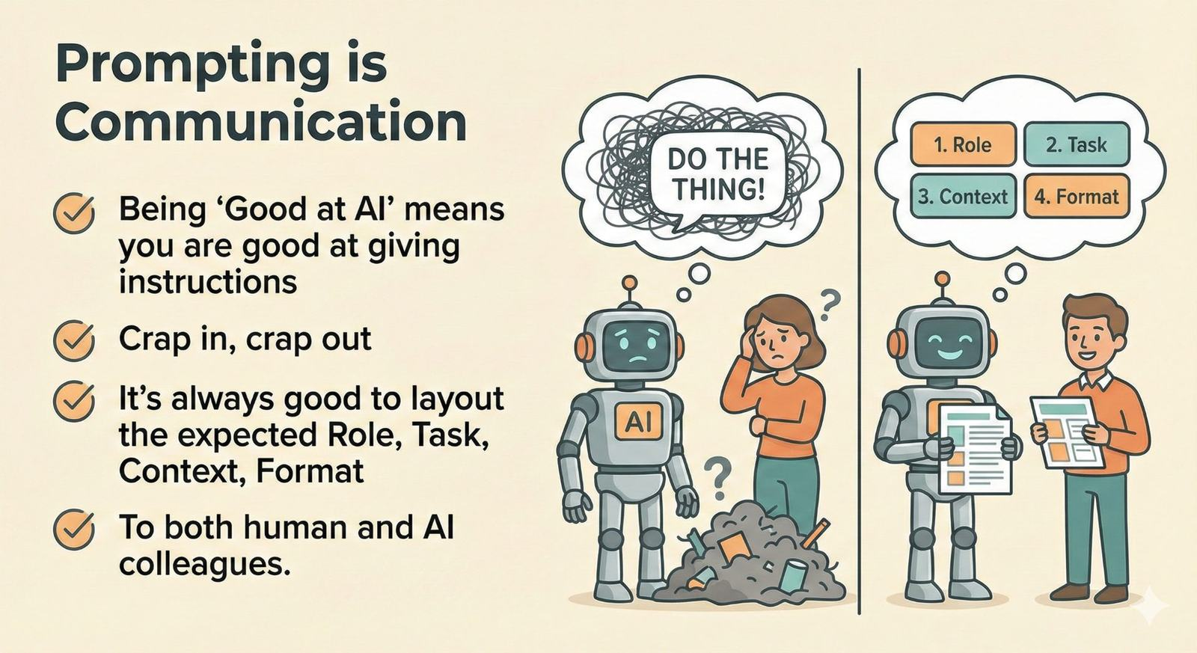
Notes:
Connect this to leadership: clear direction is a management skill.

Slide 17
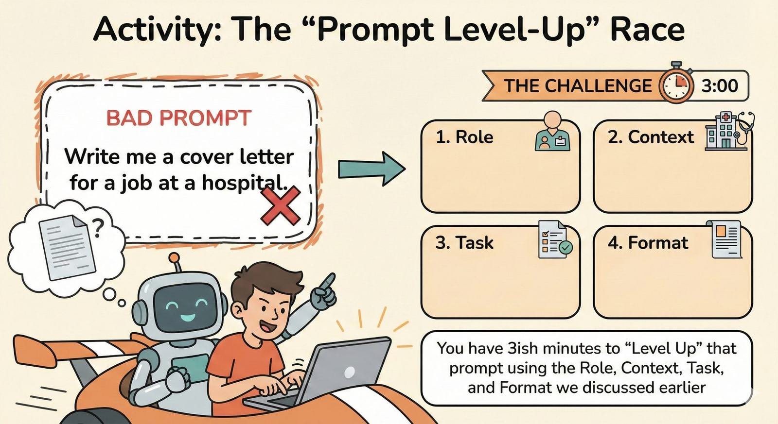

Slide 18
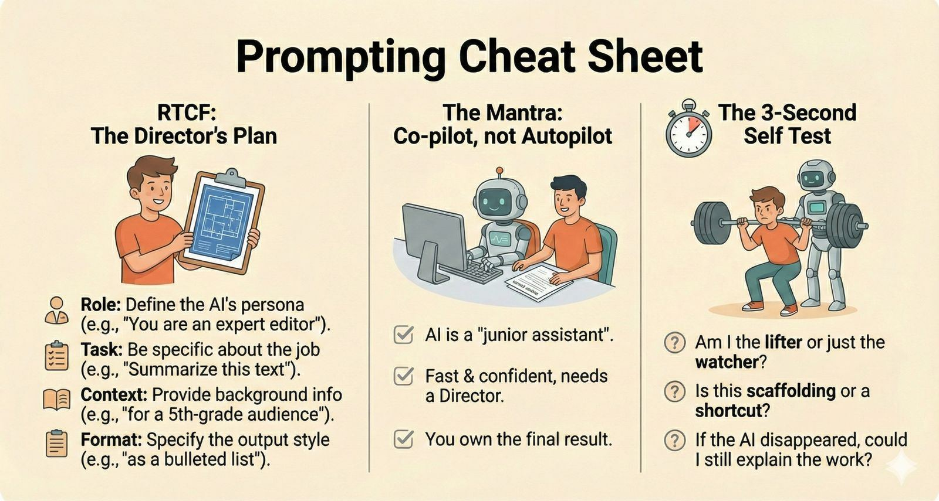

Slide 19
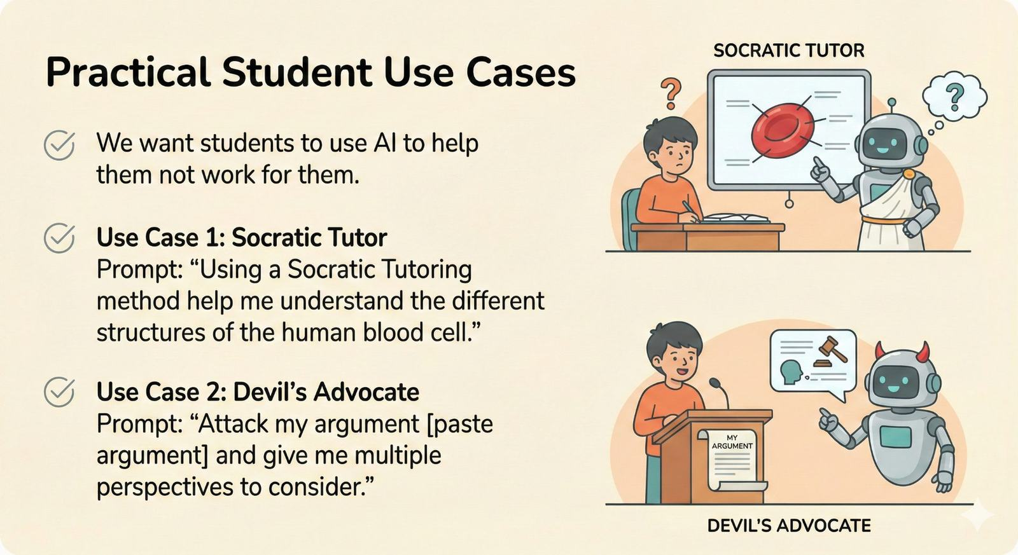
Notes:
This is where you say: “Use AI to challenge you, not carry you.”
Working with AI
Quick punchline: “Argue with it.”

Slide 20
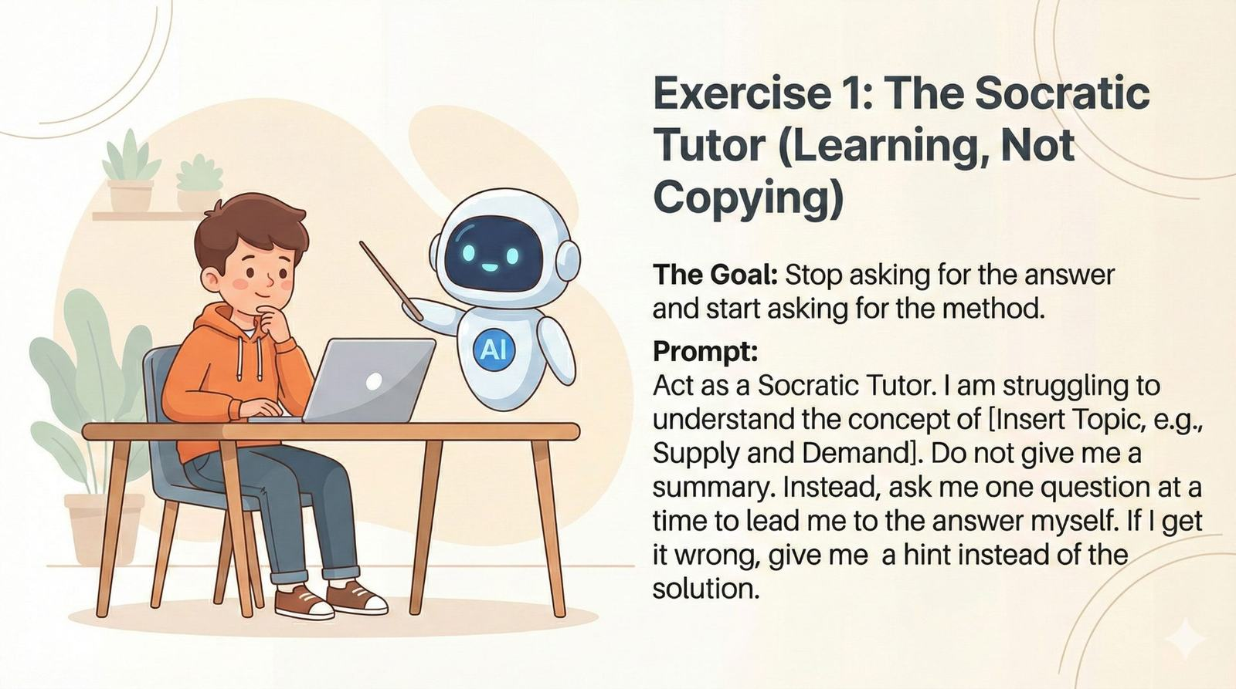

Slide 21
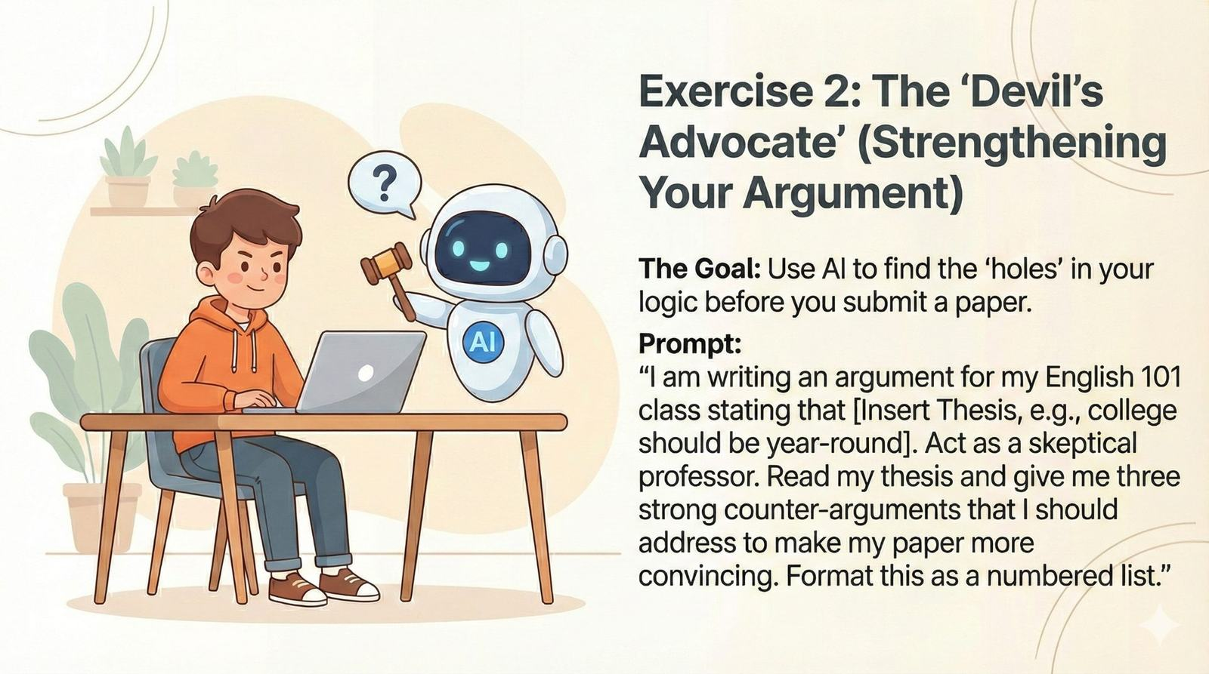

Slide 22
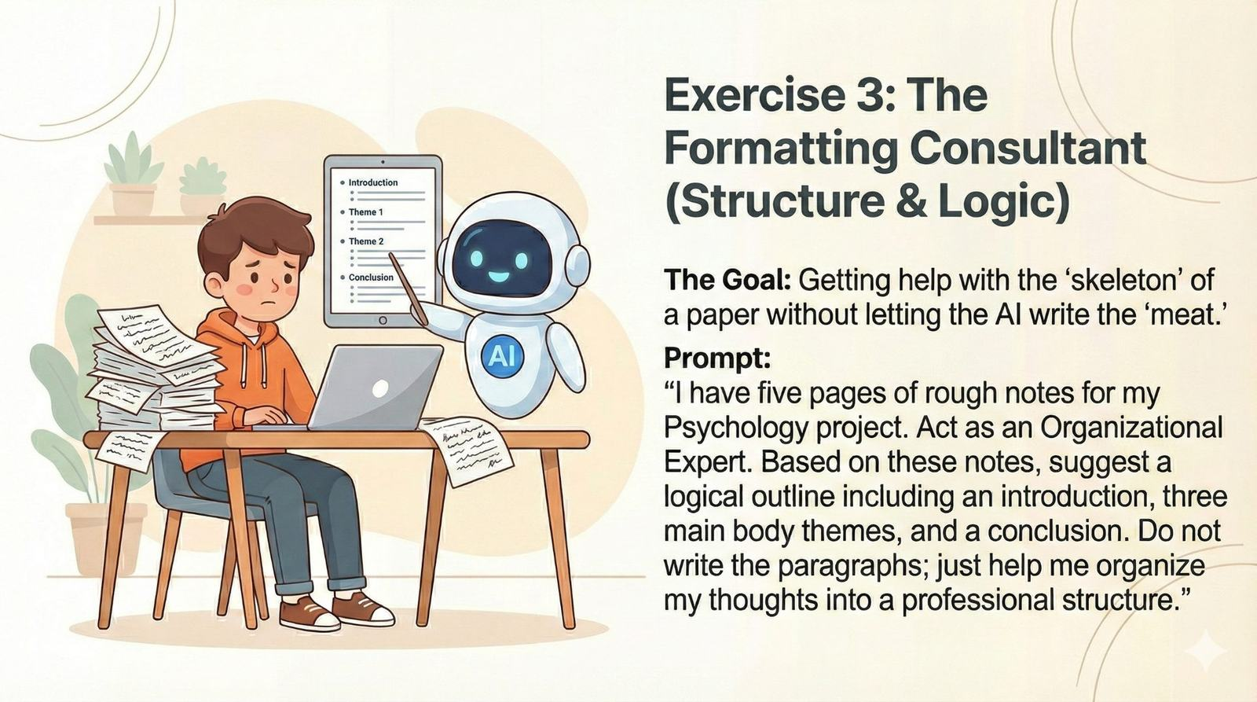

Slide 23
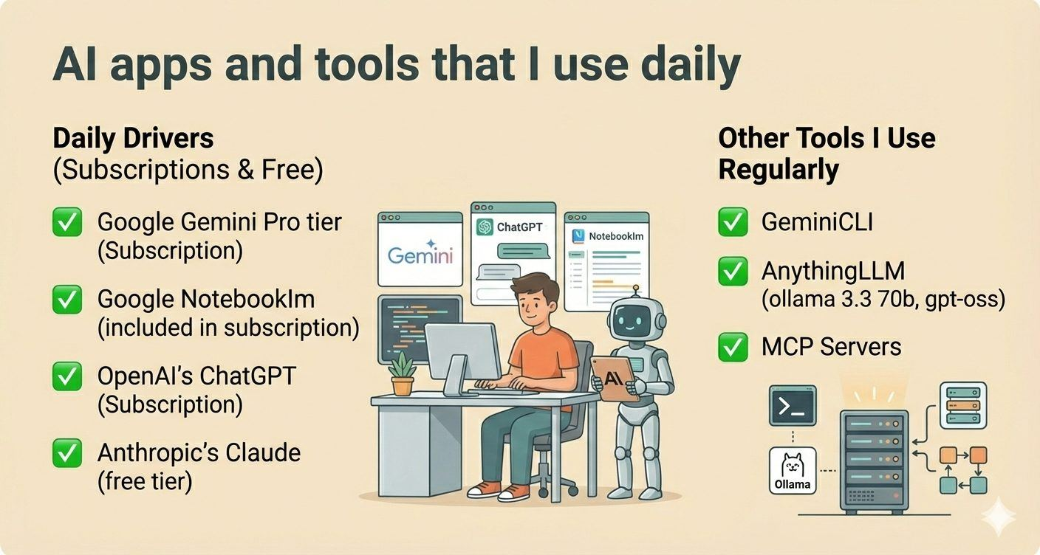

Slide 24
