Slide 1
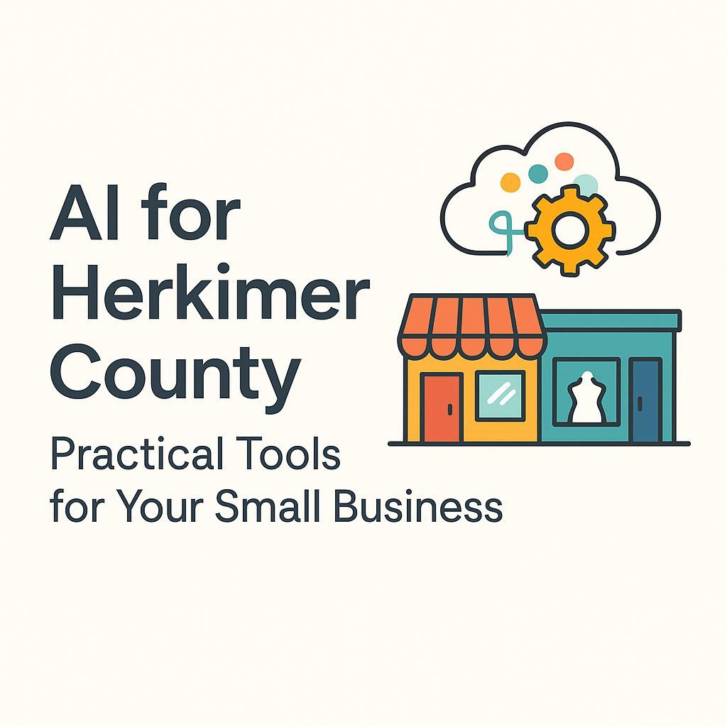
This AI Session is aimed at helping small business owners understand AI and its potential uses to help save time and boost their marketing.
Join us to cut through the hype and lean how free, easy-to-use tools can streamline your daily operations and help you grow your business.

Slide 2
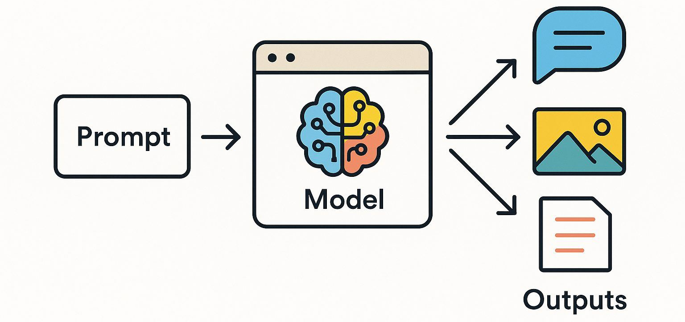
What is Generative AI?
The "Apprentice" Analogy:
  Imagine an apprentice who has read every book, studied every painting, and has heard/analyzed every song.
  You can ask this apprentice to create something new—a poem, a picture, or a song.
  It will use the patterns, styles, and structures it learned to create something entirely original.
What It Is:
  A type of AI that can create new content (conversations, stories, images, emails, reports, software code).
  It works based on a simple request, known as a "prompt".
The Business Impact:
  AI transforms from a tool that only analyzes data...
  ...into a partner that can actively collaborate in your creative and operational tasks.

Slide 3
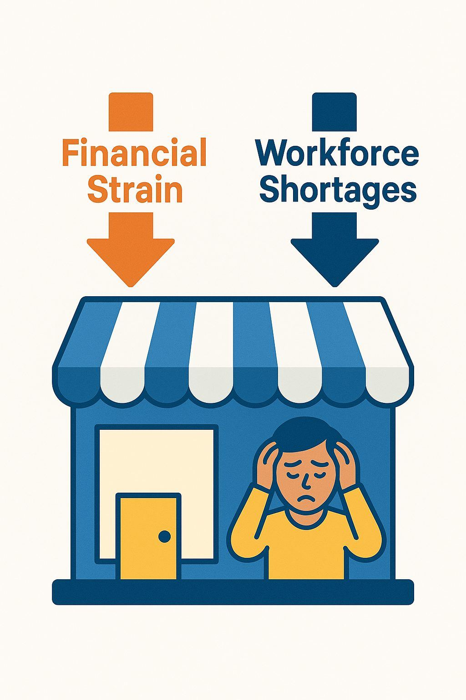
Doing More with Less
The Daily Realities (National Rural Surveys):
  “I can't find good employees."
  "My marketing just isn't working."
  "I'm struggling to compete with Amazon and online giants."
The Herkimer County Picture:
  Top Industries: Health Care, Retail, and Manufacturing all face significant pressure.
  Financial Strain: A large percent of rural businesses reported economic hardship in 2023.
  Workforce Crisis: Hiring and retaining staff is the #1 concern for rural businesses.
The Squeeze:
  Businesses face a convergence of severe financial strain and acute workforce shortages.
  The core challenge: You are being asked to achieve more with fewer people and less capital.

Slide 4
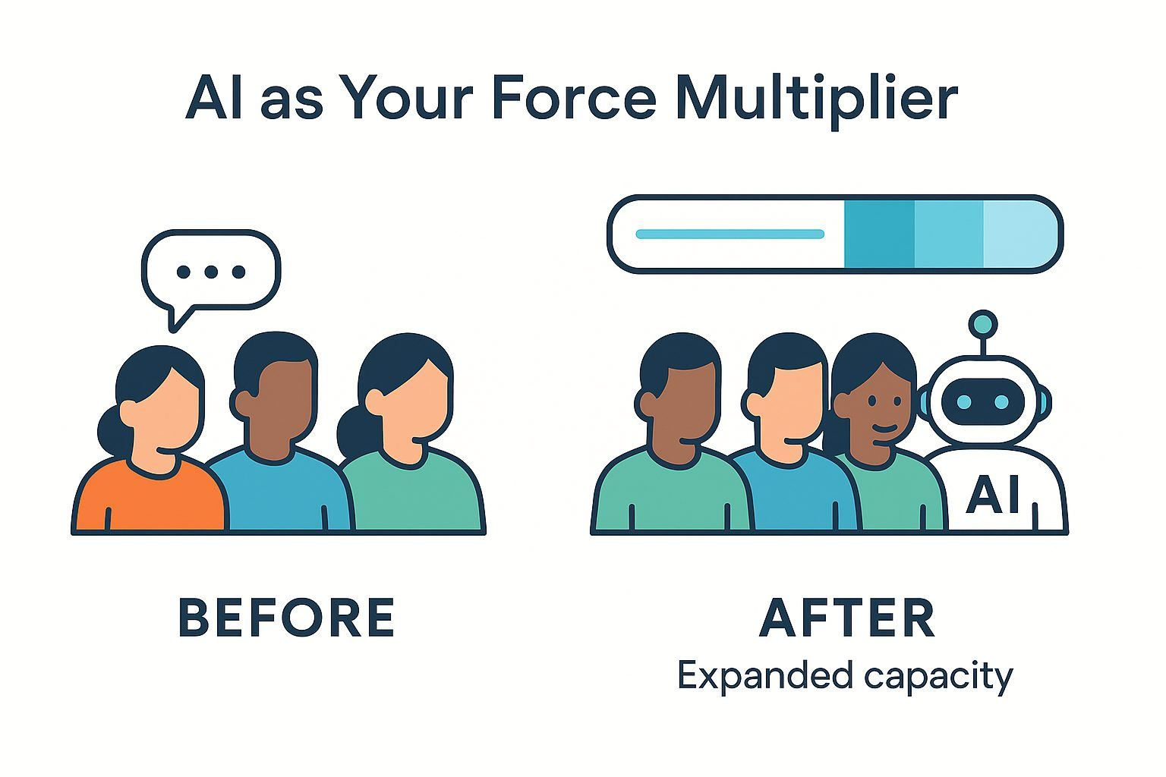
AI as Your
"Force Multiplier"
The Solution: AI is not a futuristic novelty—it's a pragmatic tool for survival and efficiency.
What It Does:
It allows a small, overworked team to:
    Automate repetitive tasks.
    Generate professional marketing content.
    Analyze business data.
The Business Impact:
  Expands your capacity without the significant cost of increasing headcount.
  Enhances the productivity of your existing team.
  Makes jobs more manageable and the business more resilient.
The Bottom Line: When new hires are scarce and every dollar counts, AI offers a way to enhance efficiency and stay competitive.

Slide 5
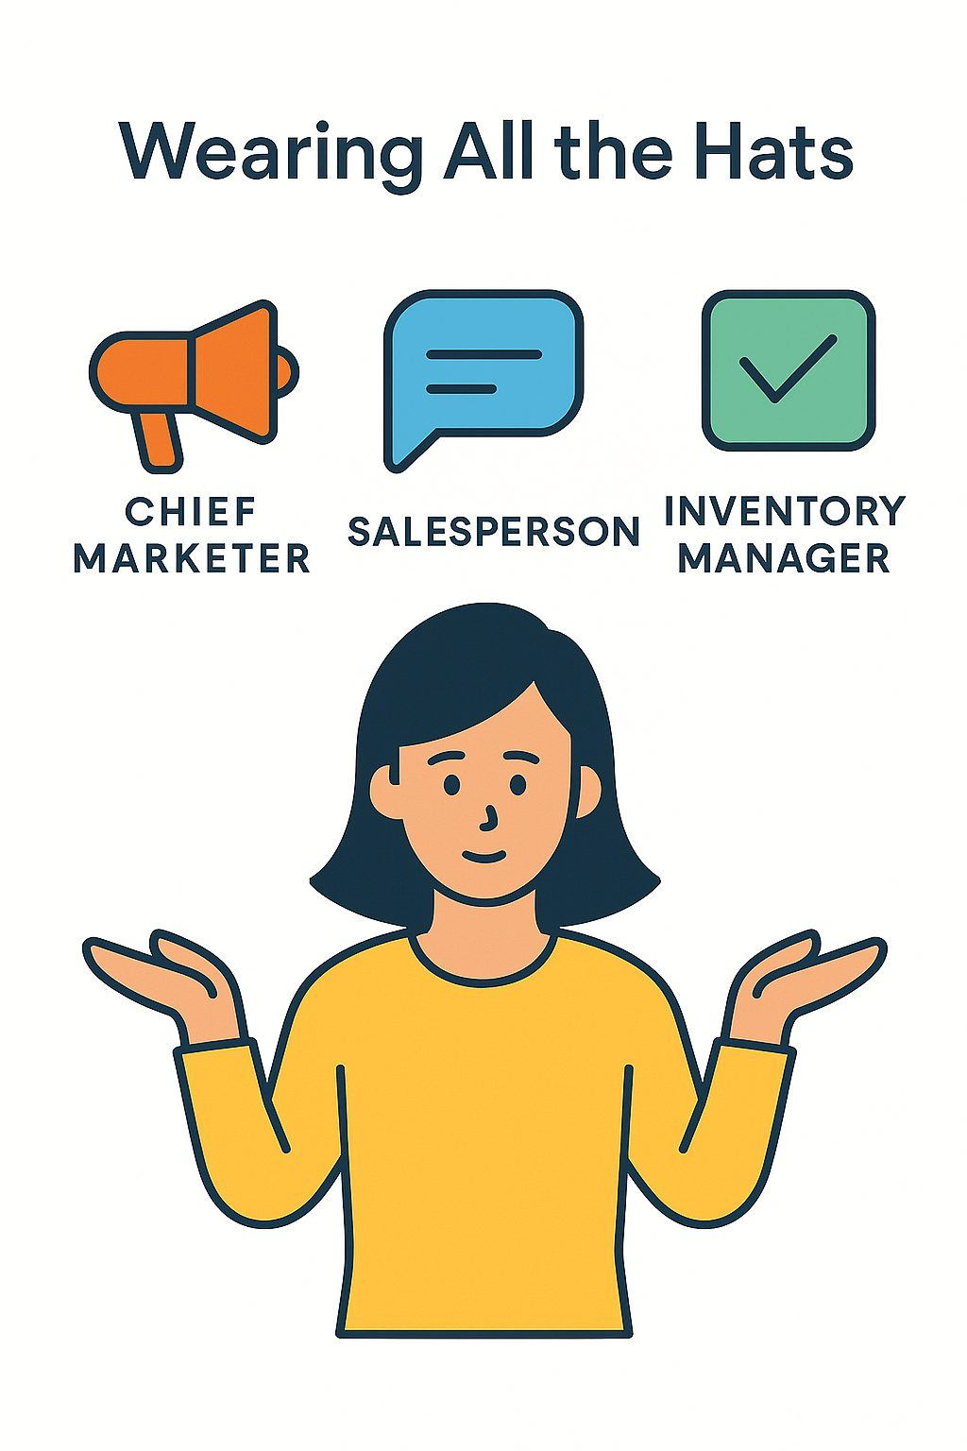
The Local Retailer's Dilemma:
Wearing All the Hats
The Scenario: Consider a unique boutique like JP's Creative Designs and AI Solutions.
Their Strength: Distinct local character and unique, custom-designed products.
Their Challenge: Competing with large online sellers.
The Core Problem: The owner is also the...
  Chief Marketer
  Salesperson
  Inventory Manager
The Result:
  Little time for consistent, high-quality marketing.
  Feeling overwhelmed by the demands of social media.

Slide 6
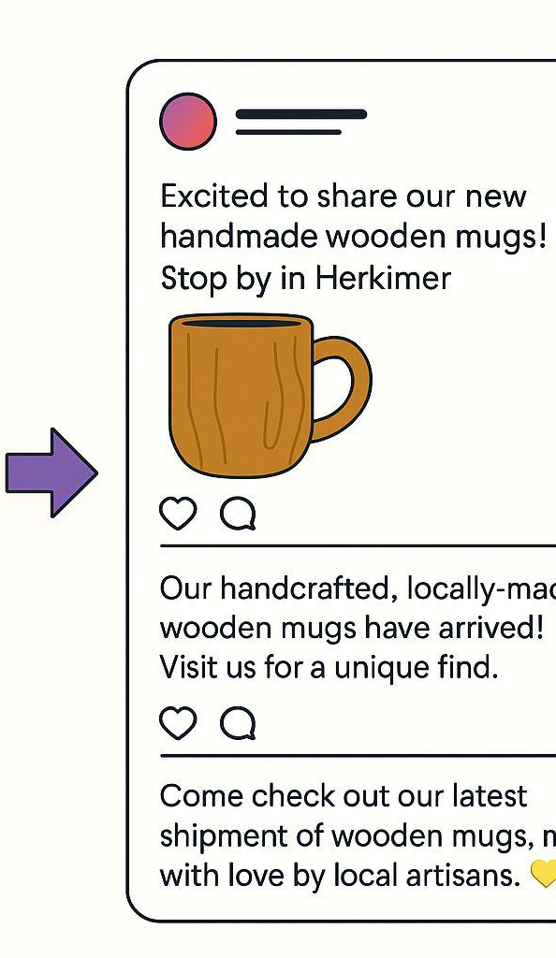
The Local Retailer's Dilemma:
The solution
The Solution: A simple prompt with a generative AI tool.
Example Prompt:
"Write three engaging Instagram posts about our new shipment of handmade wooden mugs. Mention our location and our unique, locally-crafted designs. Use a friendly, enthusiastic tone and include relevant hashtags for shopping local.“
The Results (In Seconds):
  Generates professional, ready-to-use marketing copy.
  Brainstorms promotional ideas for seasonal events.
  Writes compelling product descriptions for e-commerce.
  Drafts scripts for short promotional videos.
The Business Impact:
  Directly addresses the "marketing isn't working" & "online competition" challenges.
  Provides a constant stream of high-quality content.
  Maintains a vibrant online presence with a minimal investment of time.

Slide 7
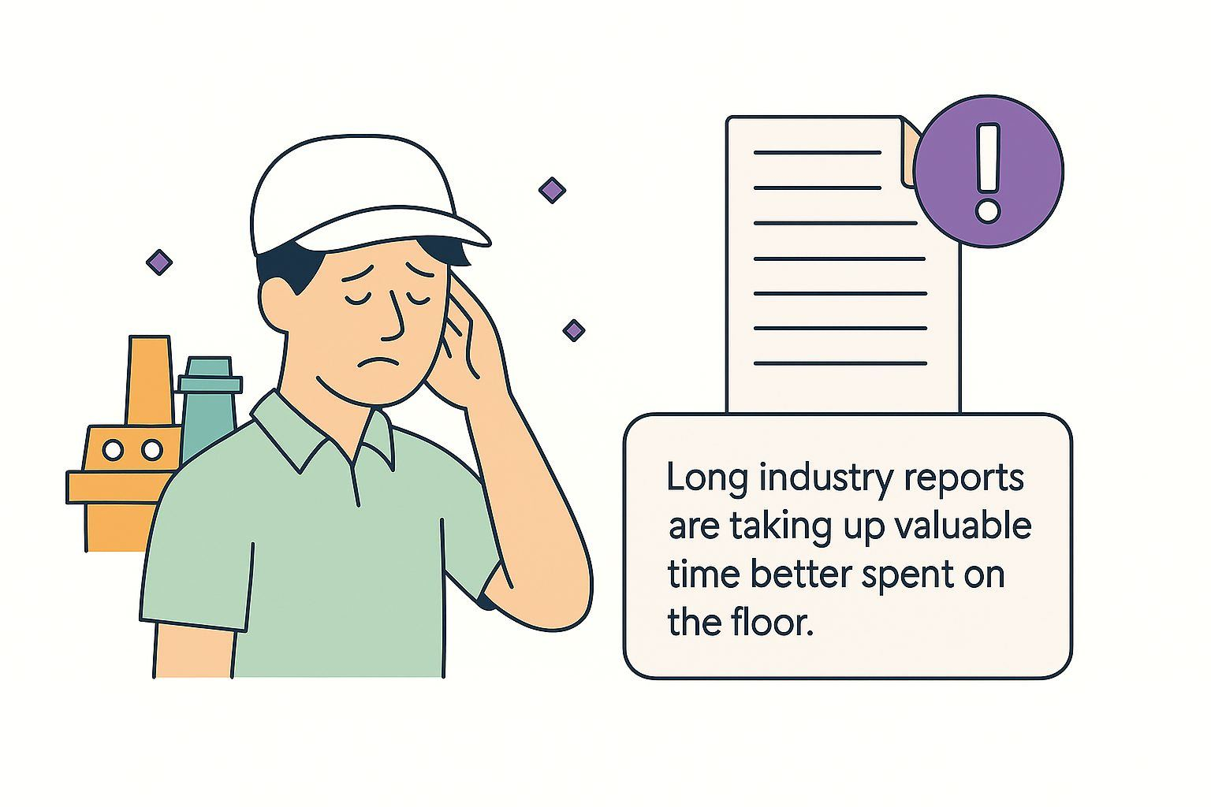
The Manufacturer's Challenge:
Information Overload
The Scenario: Consider a local manufacturer like Park's Paper Co.
Their Priorities: Efficiency, Safety, and Clear Communication are paramount.
The Core Problem: Managers are often inundated with:
  Dense technical documents
  Complex supply chain reports
  Evolving safety protocols
The Result:
  Hours lost to administrative work.
  Managers are pulled away from critical, hands-on tasks on the factory floor.

Slide 8
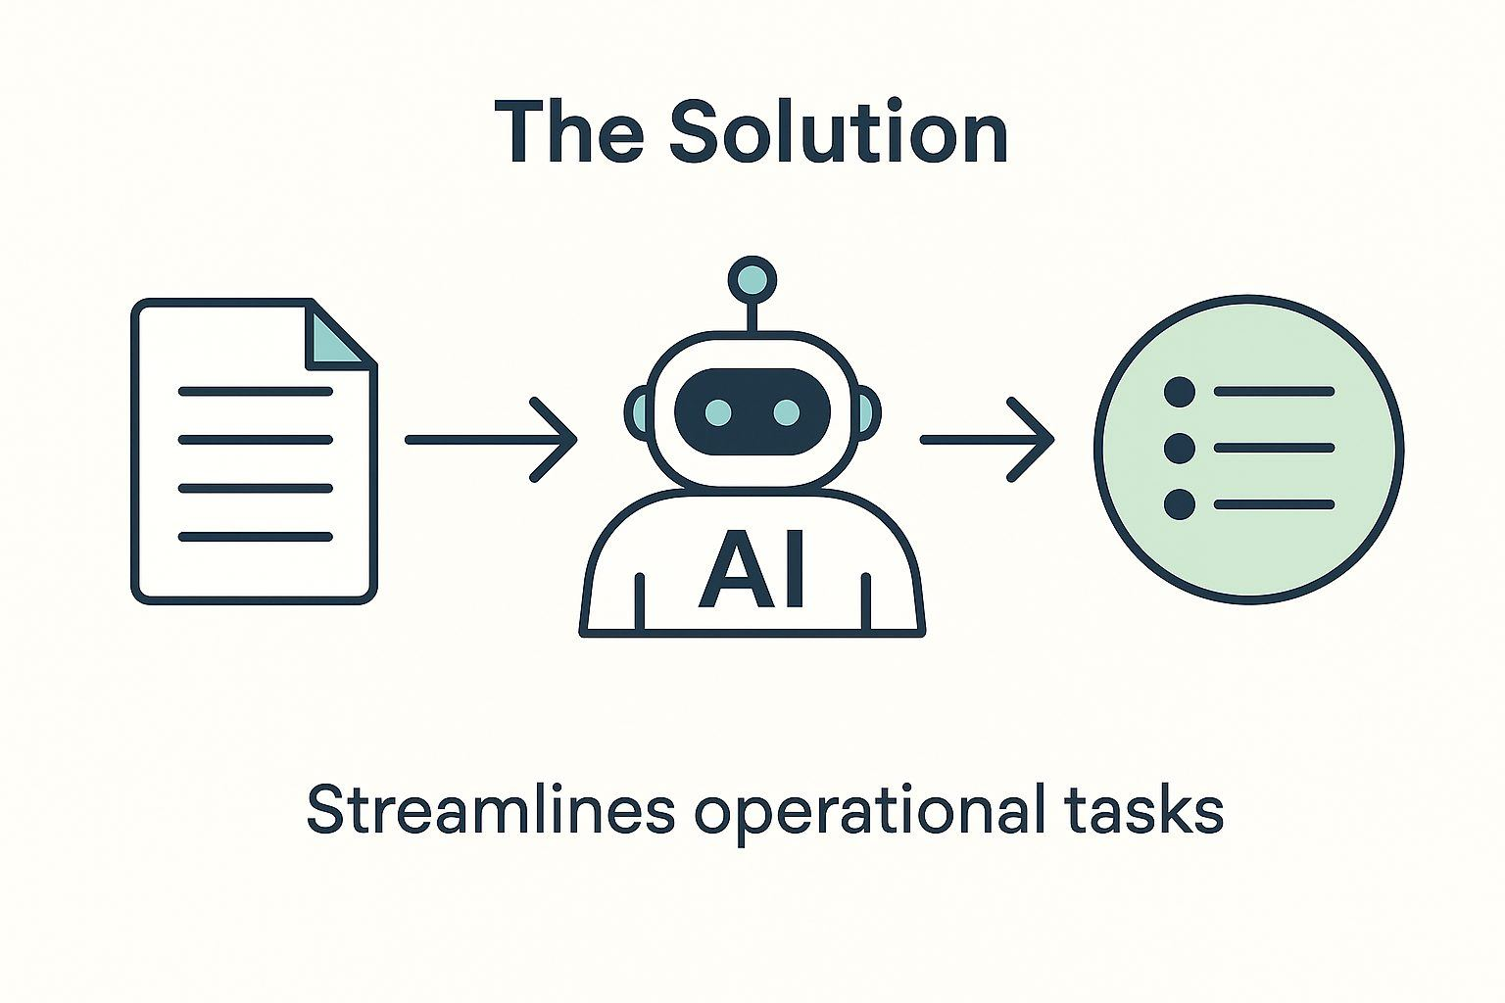
The Manufacturer's Challenge:
The solution
The Solution: An AI assistant can dramatically streamline operational and information-based tasks.
Example Prompt:
"Summarize the key findings of this 10-page supplier report into five bullet points, focusing on cost changes and delivery timelines."
More Practical or follow-up prompts:
  Drafting Internal Comms: Create a clear safety memo about new equipment.
  Developing Training: Outline a new employee training program for a specific process.
The Business Impact:
  Saves hours of reading and administrative work.
  Frees up managers to focus on the factory floor.
  Helps the existing team accomplish more, directly addressing critical workforce challenges.

Slide 9
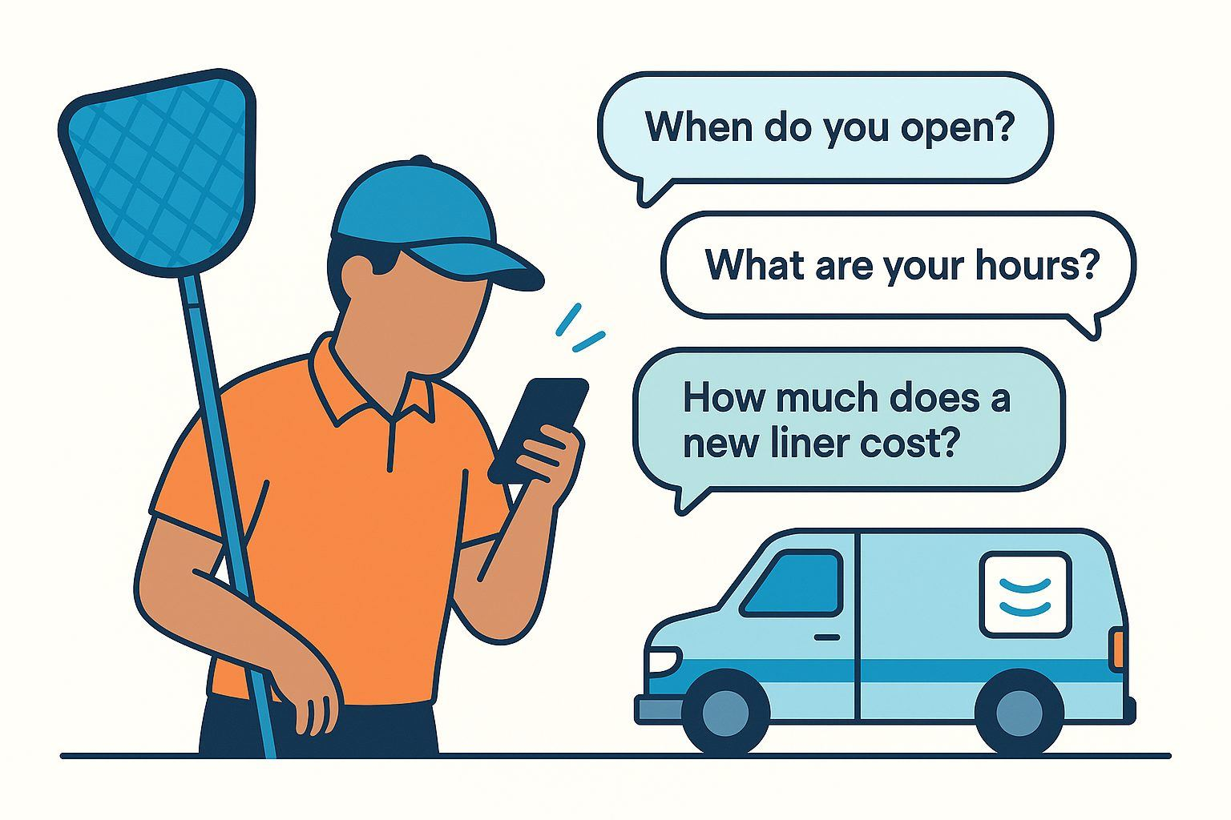
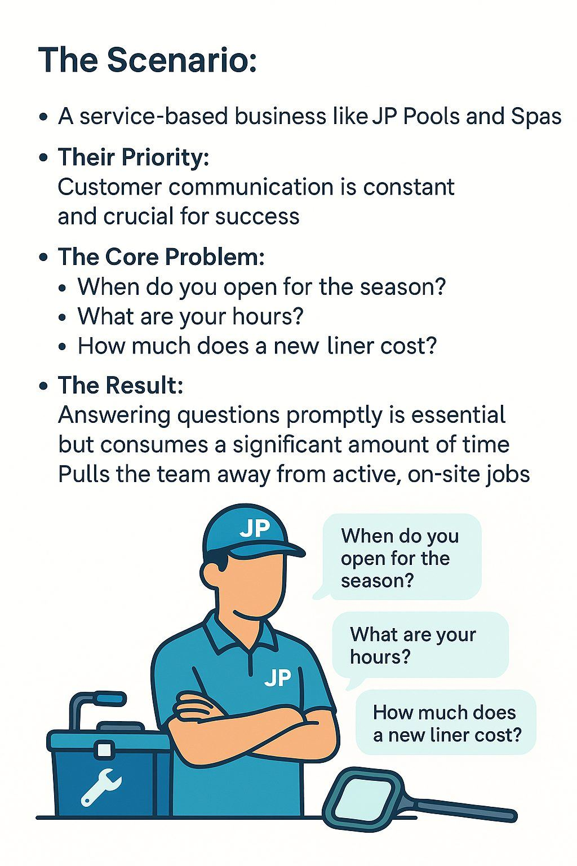
The Service Provider's Challenge:
Constant Communication
The Scenario: A service-based business like JP Pools and Spas.
Their Priority: Customer communication is constant and crucial for success.
The Core Problem: Many inquiries are repetitive and time-consuming:
  "When do you open for the season?"
  "What are your hours?"
  "How much does a new liner cost?"
The Result:
  Answering questions promptly is essential but consumes a significant amount of time.
  Pulls the team away from active, on-site jobs.

Slide 10

The Service Provider's Challenge:
The solution
The Solution: Use an AI tool to create a comprehensive library of email templates and web content.
Example Prompt:
"Draft a polite, professional email for JP Pools and Spas responding to a customer inquiry about pool opening services.
Explain our process, mention typical timelines, and include a clear call to action to book an appointment online."
More Practical Uses:
  Generate a complete website Frequently Asked Questions (FAQ) page.
  Draft the initial text for new service agreements.
The Strategic Impact:
  This isn't just "free time"; it's "strategic time".
  AI offloads repetitive tasks, allowing owners to shift from working in their business to working on their business.
  Reinvest that time into high-value activities: building local relationships, innovating new services, and planning for long-term growth.

Slide 11



Your First AI Toolkit:
A Hands-On Guide to Free & Low-Cost Tools
Google Gemini
Integrated directly into the Google Workspace suite (Gmail, Docs, Sheets).
Acts as a seamless productivity booster within the tools you already use.
ChatGPT
A powerful conversational AI.
Excels at brainstorming and generating a wide variety of written content (emails, posts, reports).
Perplexity's Comet Browser
An AI-first web browser built for research and web-based tasks.
Excels at understanding the context of the webpage you are on, allowing you to ask questions, get summaries, and automate tasks directly.
Getting started with AI does not require a large budget or a dedicated IT department.
The most powerful tools are available for free, providing an excellent way to start exploring.
The Big Three Free Platforms: An Overview
These platforms are leaders in their field, offer robust free versions, and are designed for users without technical backgrounds.
ChatGPT
  A powerful conversational AI.
  Excels at brainstorming and generating a wide variety of written content (emails, posts, reports).
Google Gemini
  Integrated directly into the Google Workspace suite (Gmail, Docs, Sheets).
  Acts as a seamless productivity booster within the tools you already use.
Perplexity's Comet Browser
An AI-first web browser built for research and web-based tasks.
Excels at understanding the context of the webpage you are on, allowing you to ask questions, get summaries, and automate tasks directly.

Slide 12
The "Answer Engine":
Perplexity & Comet Browser
What It Is:
  An AI-powered browser and search engine designed for research.
  Think of it as a research assistant, not just a creative writer.
The Core Benefit:
  It provides fast, accurate answers to complex questions with citations and sources.
  It's built to find and synthesize real-time information from the web, so you know where the answer came from.
How It Works (The "Browser"):
  It acts as your personal "thinking partner" to help you understand topics, manage tabs, and summarize web content.
Example Prompt: "What are the latest 2025 safety regulations for public spa facilities in New York State? Summarize the key changes and cite your sources."
Practical Uses:
  Conducting market research on competitors.
  Finding up-to-date legal or regulatory information.
  Understanding complex topics quickly without sifting through 10 Google links.
  Summarizing your open tabs to find the key takeaways.

Slide 13
The "Productivity Partner":
Google Gemini
What It Is:
  An AI assistant built directly into the Google Workspace tools you already use (Gmail, Docs, Sheets).
The Core Benefit:
  It's designed to handle and automate time-consuming information management tasks inside the apps you already use, seamlessly boosting your team's productivity.
How It Works (The "Prompt"):
  You can give it commands directly within your workflow. For example, in Google Sheets:
Example Prompt: "Create a project plan to launch our new website, with columns for task, owner, due date, and status."
Practical Uses:
  In Gmail: Summarize a long, complex email chain in seconds.
  In Google Docs: Instantly draft a business proposal, report, or email from a simple prompt.
  Across Workspace: Refine existing text, generate fully formatted tables, and organize information.
The Bottom Line:
  This is your go-to tool for saving significant time on administrative tasks and improving your team's operational efficiency.

Slide 14
The "All-Rounder":
ChatGPT
What It Is:
  A powerful and highly versatile conversational AI.
  It's like having a universal assistant for brainstorming, writing, and refining ideas.
The Core Benefit:
  It excels at creating a wide variety of new written content from scratch.
  It's perfect for when you have a blank page and need a first draft.
How It Works (The "Prompt"):
  You give it a role and a task in plain English.
Example Prompt: "Act as a small business marketing expert. Write a 3-paragraph blog post about the top 3 benefits of professional pool maintenance for spring. Use a friendly, helpful tone."
Practical Uses:
  Drafting emails and customer replies.
  Brainstorming marketing ideas and social media posts.
  Writing blog posts, website copy, and product descriptions.
  Summarizing long articles or documents.
The Bottom Line:
  The free version is incredibly powerful and is the best place to start for generating new content and ideas.

Slide 15
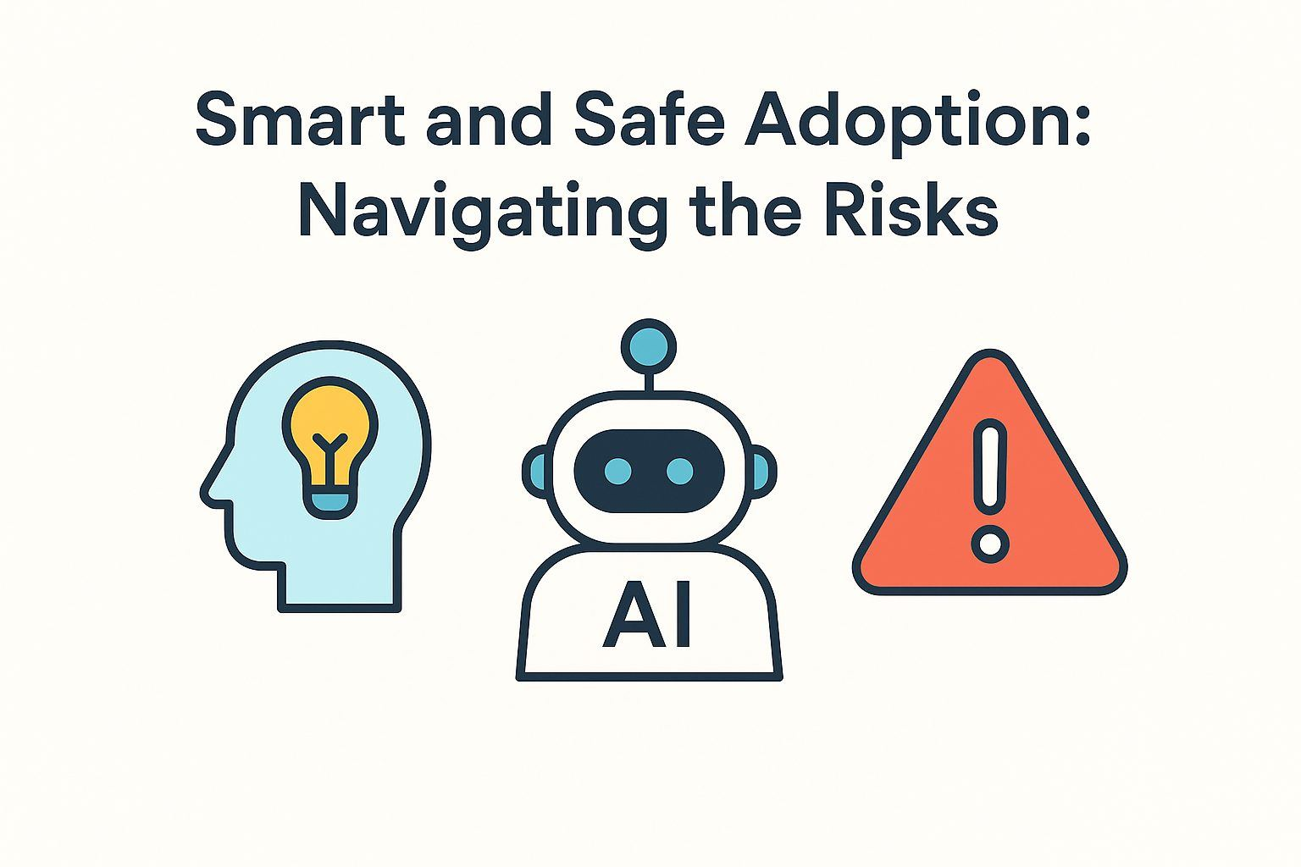
Smart & Safe Adoption:
Navigating the Risks
The Reality: Adopting any new technology requires a clear understanding of both its benefits and its potential risks.
The Priority: With AI, being a smart and safe user is paramount.
The Goal: To protect your business, your data, and your customers.

Slide 16

The Most Important Rule:
You Are the Expert
The Principle: An AI model is a powerful assistant, but it is not the business owner.
What AI Lacks (and You Have):
Nuanced knowledge of the Herkimer County market.
Personal relationships with your customers.
Years of hands-on craft and industry knowledge.
Your Most Valuable Asset:
Your expertise. AI should be used to amplify that expertise, not replace it.
The Best Practice: "Human in the Loop"
Always review, edit, fact-check, and ultimately approve any work the AI produces.
You are in control, the AI is the tool.

Slide 17
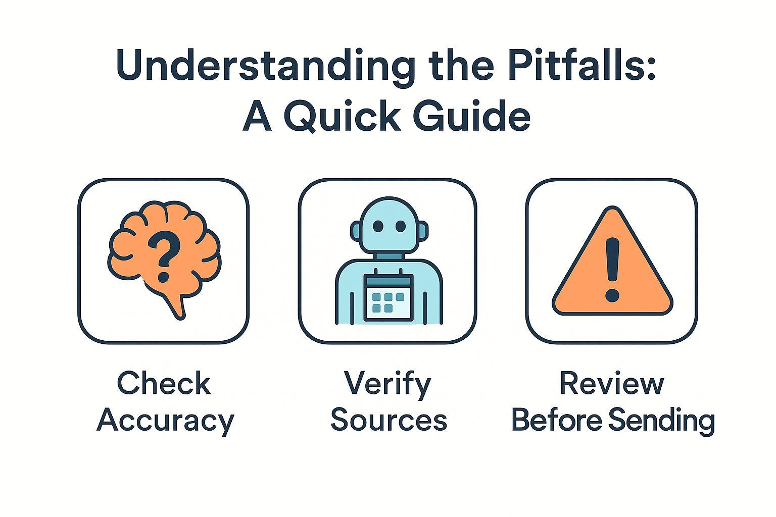
Understanding the Pitfalls:
A Quick Guide
The Reality: While powerful, AI tools have inherent limitations and risks that every user must understand.
The Goal: To avoid potential problems by being a smart and safe user.

Slide 18
Pitfall #1:
AI "Hallucinations" (Invented Information)
What It Is:
An AI will confidently and authoritatively invent information.
It may state incorrect facts, create links to non-existent pages, or give nonsensical answers.
Why It Happens:
The AI is designed to sound plausible (predicting the next likely word), not to be truthful.
The Analogy:
Treat AI as a "brilliant but sometimes unreliable intern" whose work always needs checking.
THE RULE:
Always fact-check any information generated by AI, especially statistics, names, historical facts, or legal information.

Slide 19
Pitfall #2:
Data Privacy & Security
The Risk:
Free, public AI tools (like ChatGPT) learn from the data you input.
Your prompts could become part of the data pool used to train future models.
The Cardinal Rule:
NEVER enter sensitive or confidential information into a public AI tool.
This Includes:
Customer names or contact details
Private employee records
Proprietary business plans or financial data
The Analogy:
Treat any information you enter as if you were writing it on a public postcard.

Slide 20
Pitfall #3:
Copyright & Originality
The Risk:
AI learns from content scraped from the internet. It could generate text or images that are substantially similar to existing copyrighted material.
The Responsibility:
You, the user, are legally responsible for the content you publish—not the AI tool.
The Best Practice:
Always use AI-generated content as a starting point or a first draft.
Heavily edit and infuse it with your business's unique voice, style, and information to ensure it becomes an original work.

Slide 21
Why This Guidance is Critical in Herkimer County
The Core Asset:
In a close-knit community, your reputation and trust are paramount.
The Magnified Risk:
A single, highly visible error (a "hallucinated" promotion, a privacy breach) can cause disproportionately large damage compared to an anonymous corporation.
The Local Impact:
An AI-driven mistake isn't an "anonymous corporate error."
It's an error from "the bakery on Main Street."
The impact is personalized and magnified by community networks.
The Bottom Line:
Being smart and safe with AI is not just a technical rule; it is a crucial strategy to preserve your business's reputation.

Slide 22
Conclusion
It is not a technology reserved for large corporations in distant tech hubs; it is an accessible and powerful new partner for any enterprise.
AI can help you enhance productivity, improve marketing, and compete more effectively in a challenging economic environment.

Slide 23
Key Takeaways
AI is an accessible, practical tool that can be implemented today by businesses in Herkimer County.
It offers tangible solutions to key local challenges, including workforce shortages, marketing effectiveness, and operational productivity.
Getting started is free and low-risk with powerful tools like Google Gemini, ChatGPT, and Perplexity.
The business owner's expertise is irreplaceable. The most effective approach is to always keep a "human in the loop" to review, edit, and ensure the safe and ethical use of AI.

