Slide 1


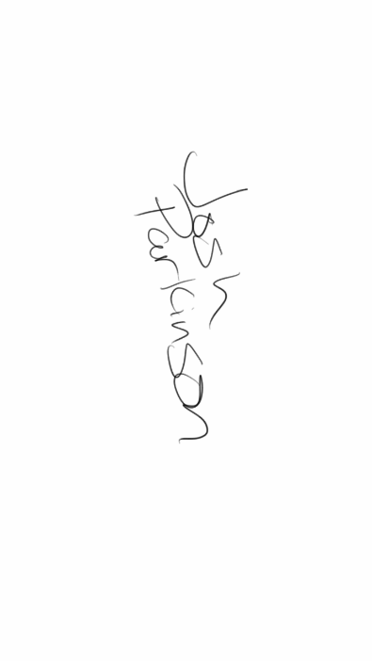
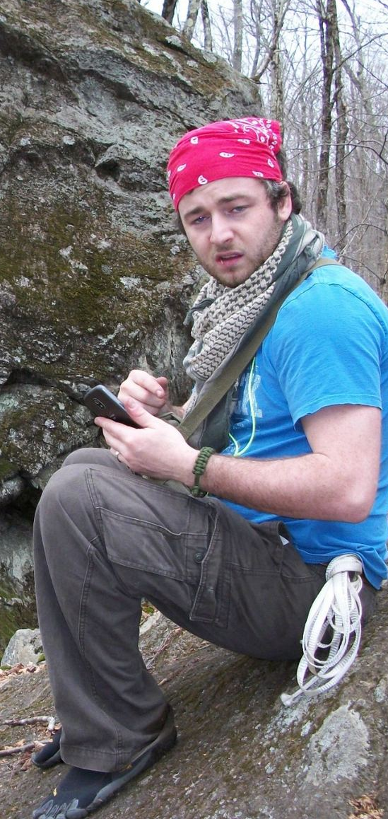

Virtual Practicum: Who are we?!
Personal Interests
Technology
Backpacking
Video games
Playing Guitar
Building things…I’m terrible at it though
Professional Background
College Substance and Alcohol Prevention Specialist
  Create edu information relating to Alcohol and Other Drugs (AOD)
  Create brochures and media related material for AOD
  AOD Advisory Board Co-Chair
  SADD Student Club Advisor
  Much, much more…
First Year Seminar (Freshmen Seminar) Adjunct
  4 Sections of traditional face to face class instruction.
Professional Interests
Game Based Learning
Preventative Substance and Alcohol methods
Teaching and Education
Experience in Virtual Worlds
Minimal experience in “Second Life” – only in LETTP course
Played several MMO’s (Massive Multiplayer Online)
Some “ClassCraft” experience
Me enjoying my two favorite hobbies:
Tech stuff
Backpacking

Slide 2

Where I think I want to explore:
Special Skills:
Design
  Infographics
  Brochures
  Curriculums
  Videos
I want to explore the overall topic of Game Based Learning or gamification within learning environments. I know some of you have been in classes with me in the past, and know well enough that this is mostly my goal. I think that this class is going to help me with design ideas and resources to fulfill my goal.
I am willing to do co-operative work as well…in fact, I like working in a team better than solo. So, just let me know and perhaps we can work together!
Gaming
  Some experience in level design with AGFPro and RPG Maker
  Play all kinds of games (digital and Tabletop)
What attracts and "glues" kids to today's video and computer games is neither the violence, nor even the subject matter, but rather the learning the games provide. Kids like, and all humans love, to learn when it isn't forced on them."
-Marc Prensky
C++/html/java programming
  Not very good…but can do something's.
Places that have of great interest to me:
http://www.classcraft.com/
http://www.minecraftedu.com/
http://www.instituteofplay.org/

