Slide 1

The Long Tail
New Media, New Literacies

Slide 2
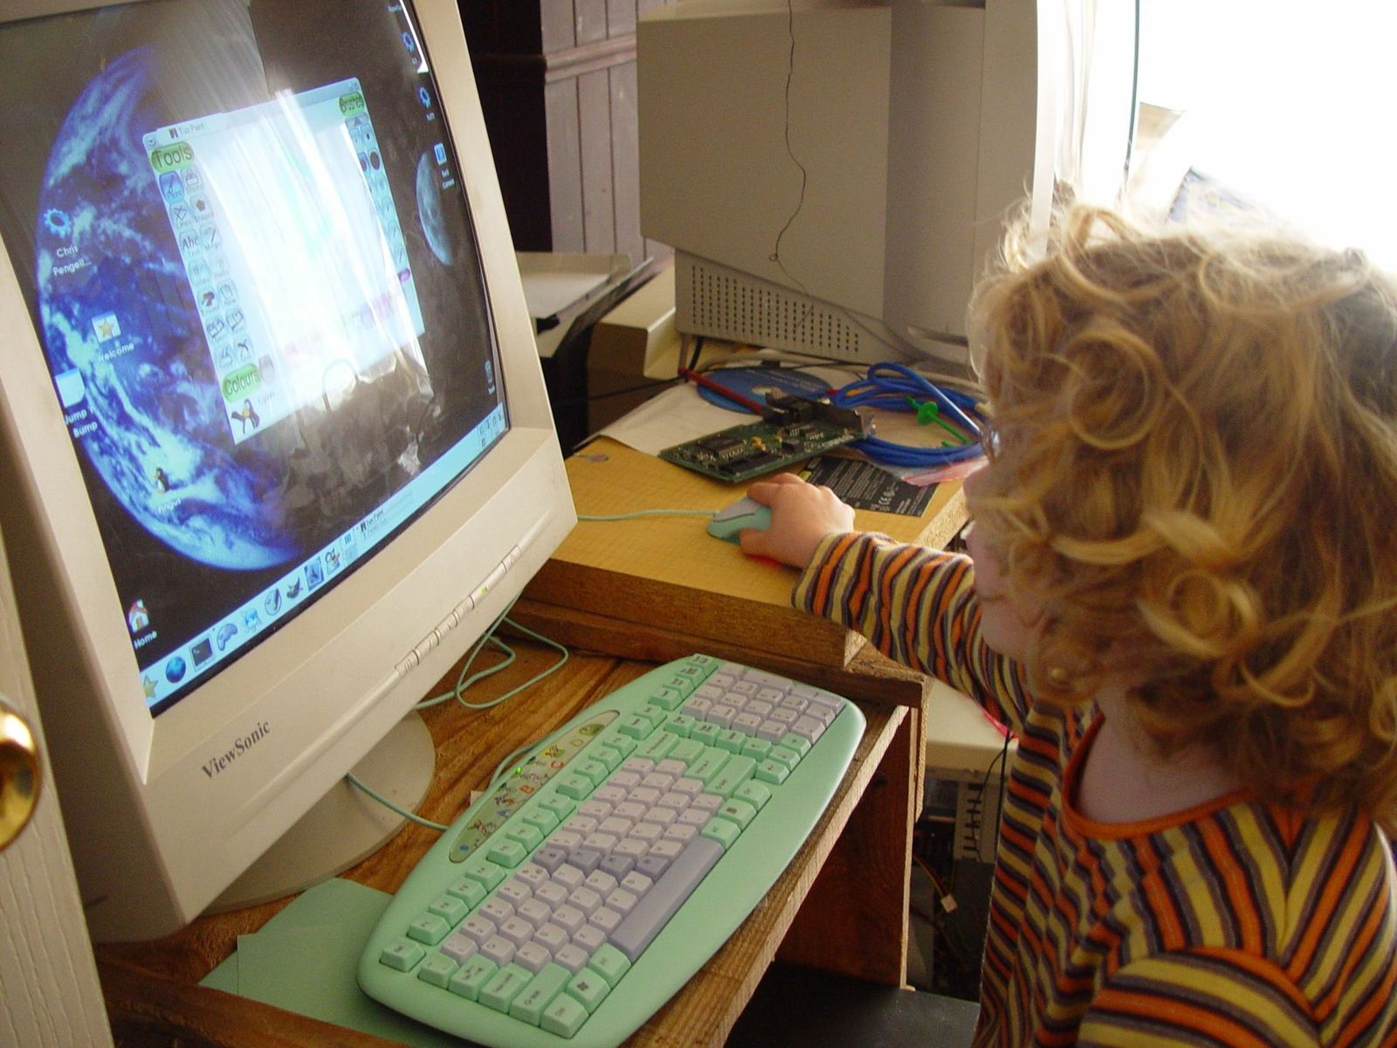
  Increased our Connections
  To each other
  To information
  To niche interests
  New Literacies
  Search
  Information filtering

Slide 3
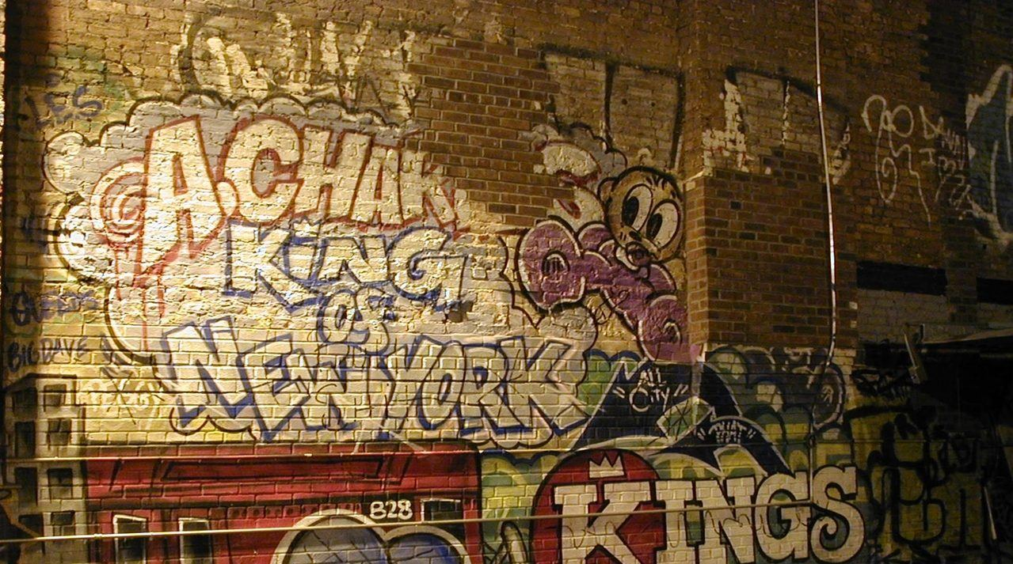
Net Neutrality Is Threatened
What do we stand to lose?
Will we lose access to the
Long Tail culture and connections we have built?

Slide 4
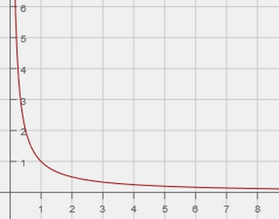
Math of
The Long Tail
y=x⁻¹
y=1/x
Power Law Curve

Slide 5
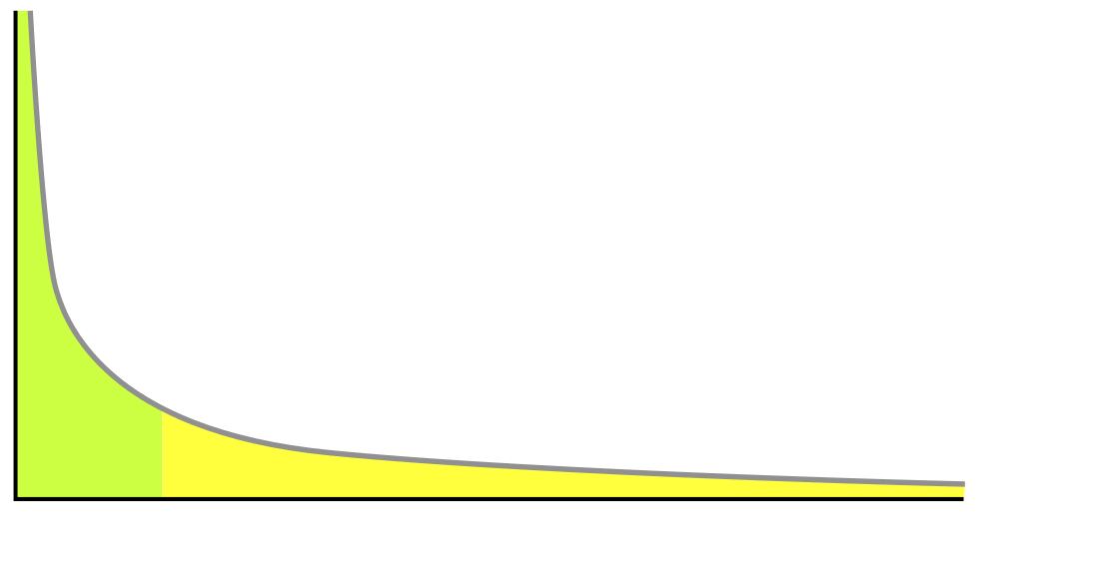
Online Sales of 2 Books On the Power Curve
$400,000
Earnings >>
$400
10
Sales Rank >>
900

Slide 6
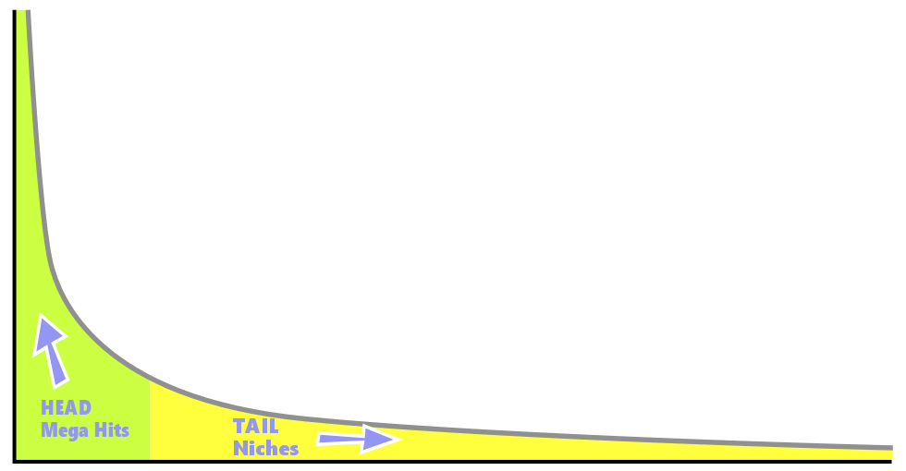
Power Law Curve showing the Head and Long Tail
$$ Earnings $$ >>
Sales Ranks >> Base curve image, Kraynen (2006)

Slide 7

Because of the nature of “hits”,
Most things are in the Tail.
“If it isn’t a hit, it’s a miss”
“amateur=amateurish”
“if it were good, it would be popular”
These ideas show
scarcity thinking.
Many products and ideas
in the Tail are of high quality.
Public Domain image by Senior Airman Dillon White, Courtesy: US Air Force

Slide 8

Aggregation and Filtering
technologies lead us further
down the Long Tail.
New Literacies
Develop as we search and use recommendation to navigate the Long Tail

Slide 9
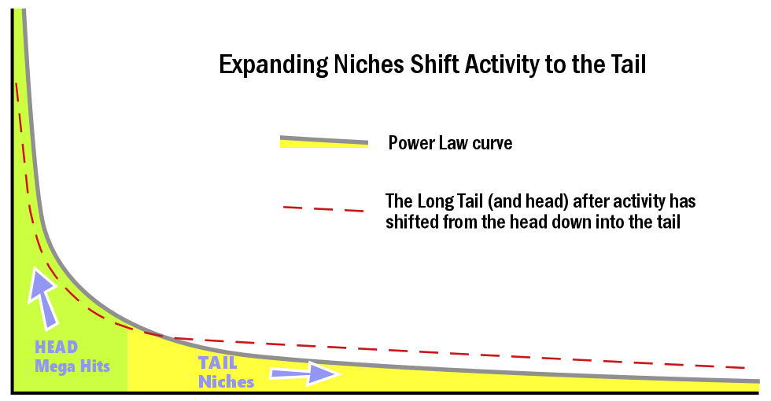
Expanding Niches Shift
Activity to the Tail
$$ Earnings $$ >>
Sales Ranks >> Base curve image, Kraynen (2006)

Slide 10

…niche markets and niche interest groups that have developed in the Long Tail have connected us to each other in unprecedented ways. They have created the landscape of some of our most unlikely and most valued connections.

Slide 11
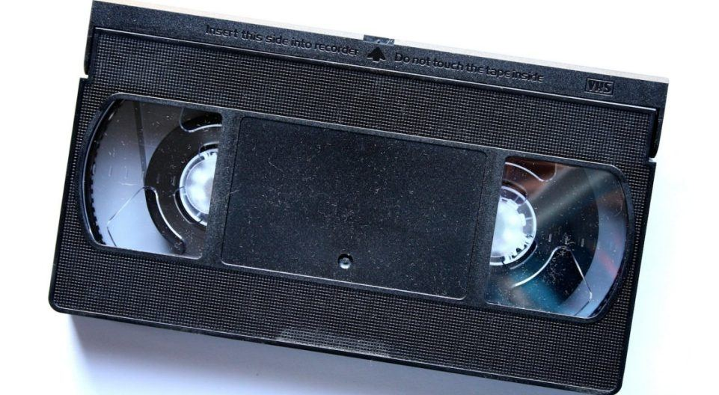
Tons of choices
Explosion of Choice
On Movie Night
70s – 1s of choices
90s – 100s of choices
Now – 100,000s of choices

Slide 12

As we venture down the Long Tail into niches that are new to us
our skills increase, we develop new ways of interacting.
Skills
Accessibility

Slide 13
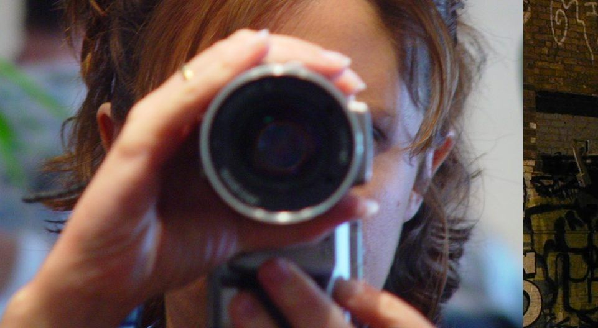
Attention Transacting
Elicit Information
Validate Information
Use Information Appropriately
Build Trust and Honor in online relationships

