Slide 1
Brief look at different substances
Substance and Alcohol
Overview
Joshua Parkinson
Substance and Alcohol Prevention Educator
Class presentation

Slide 2
Alcohol
A more in depth view on alcohol and its effects

Slide 3
Some National Statistics
4 out of 5 students drink alcohol
About Half of the students who report drinking, consume alcohol by binge drinking.
53.4% of students reported missing a class because of alcohol use
33.4% reported performing poorly on a test or project because of alcohol use
48.2% reported experiencing memory loss because of alcohol use
39.7% reported that alcohol use by other students interrupts their studying

Slide 4
More Stats!
Death: 1,825 college students between the ages of 18 and 24 die each year from alcohol-related unintentional injuries.
Assault: More than 690,000 students between the ages of 18 and 24 are assaulted by another student who has been drinking.
Sexual Abuse: More than 97,000 students between the ages of 18 and 24 are victims of alcohol-related sexual assault or date rape.
Injury: 599,000 students between the ages of 18 and 24 receive unintentional injuries while under the influence of alcohol.
Academic Problems: About 25 percent of college students report academic consequences of their drinking including missing class, falling behind, doing poorly on exams or papers, and receiving lower grades overall.
Health Problems/Suicide Attempts: More than 150,000 students develop an alcohol-related health problem and between 1.2 and 1.5 percent of students indicate that they tried to commit suicide within the past year due to drinking or drug use.
Drunk Driving: 2.8 million students between the ages of 18 and 24 reported driving under the influence of alcohol.

Slide 5
Alcohol
Is classified as a Depressant
Is the number one used drug on campus
4 out of 5 college students nationwide consume alcohol
Half of those students binge drink
Is considered a great “Equalizer”
Can affect school and athletic performances up to 3 days after drinking
A leading cause of poor academic performance
A leading cause of motor vehicle deaths among college students

Slide 6
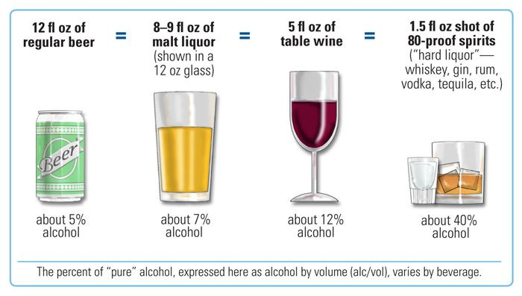
What is a drink?

Slide 7
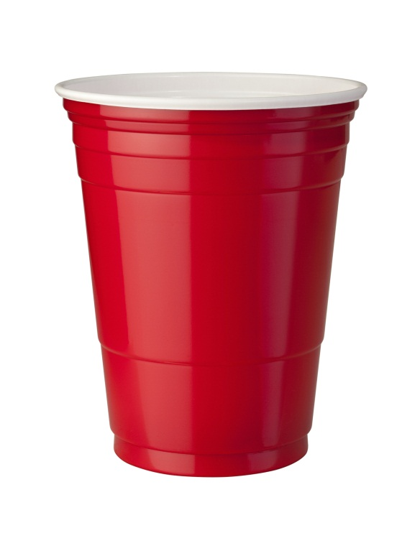


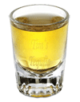
Or in College terms…
12oz Beer
5oz. Wine
1.5oz shot
One cup doesn’t mean one drink.

Slide 8

GPA vs Drinks
“A” Students
“B” Students
This is how each letter grade student drinks per week on average.
“C” Students
“D and F” Students

Slide 9
Short Term Effects
Alcohol

Slide 10
In low doses, alcohol produces:
A relaxing effect
Reduced tension
Lowered inhibitions
Poor concentration
Slow reflexes
Slow reaction time
Reduced coordination
Slower brain activity
Sensations and perceptions that are less clear
In medium doses, alcohol produces:
Slurred speech
Sleepiness
Altered emotions
Poor vision
Sleepiness and disruption of sleeping patterns
Increased urine production
More blood flow to skin surface
Lower core body temperature
In high doses, alcohol produces:
Vomiting
Uncontrolled urination
Uncontrolled defecation
Breathing difficulties
Passing out
Alcohol poisoning
Coma
Possible death

Slide 11
Long Term Effects
Disrupts normal brain development;
Liver damage and cirrhosis of the liver;
Brain cells die, decreasing brain mass;
Stomach and intestinal ulcers and destroyed organs;
Blood pressure increases, causing heart disease, heart attack, or stroke;
Male sperm production decreases;
Lower levels of iron and vitamin B, causing anemia;
Alcoholism;
Fetal alcohol syndrome in unborn children; and
Death.

Slide 12
So…what to look for
When someone has drank too much.

Slide 13
Signs of Alcohol Poisoning
Confusion
Vomiting
Seizures
Slow breathing
(less than eight breaths a minute)
Irregular breathing (a gap of more than 10 seconds between breaths)
Blue-tinged skin or pale skin
Low body temperature (hypothermia)
Passing out (unconsciousness) and can't be awakened
Notes:
It's not necessary to have all these signs and symptoms before you seek help. A person who is unconscious or can't be awakened is at risk of dying.

Slide 14
What to do…
Call 911 or your local emergency number immediately. Never assume that a person will sleep off alcohol poisoning.
Be prepared to provide information. If you know, be sure to tell hospital or emergency personnel the kind and amount of alcohol the person drank, and when.
Don't leave an unconscious person alone. Because alcohol poisoning affects the way your gag reflex works, someone with alcohol poisoning may choke on his or her own vomit and not be able to breathe. While waiting for help, don't try to make the person vomit because he or she could choke.
Help a person who is vomiting. Try to keep him or her sitting up. If the person must lie down, make sure to turn his or her head to the side — this helps prevent choking. Try to keep the person awake to prevent loss of consciousness.
Notes:
It can be difficult to decide if you think someone is drunk enough to warrant medical intervention, but it's best to err on the side of caution. You may worry about the consequences for yourself or your friend or loved one, particularly if you're underage. But the consequences of not getting the right help in time can be far more serious.
Talk about the Good Samaritan Law

Slide 15
Marijuana
A more in depth view on Marijuana and its effects

Slide 16
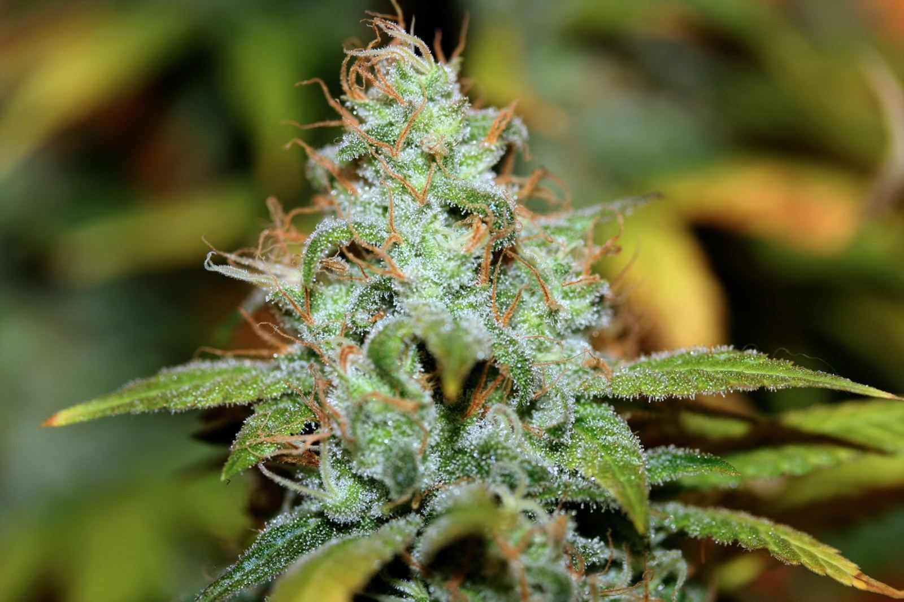
Genus Cannabis 483 Known Compounds
Principal psychoactive constituent: delta 9-tetrahydrocannibinol (THC)

Slide 17
Marijuana safer than Cigarettes?
What do you think?
Why?

Slide 18

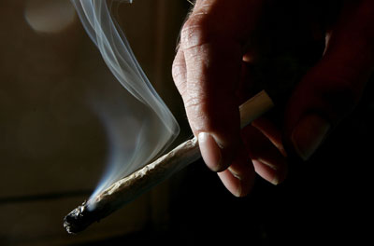
Mercury
PVC Piping
Paint Thinner
Fiber Glass
Rat Poison
Rat Poison
Ammonia
Formaldehyde
Ammonia
Formaldehyde
Urea
Arsenic
Paint Thinner
PVC Piping
Nickel
Nickel
Arsenic
Mercury
Cigarette
Joint
The chemicals don’t get poured in…they are found when the plant is burned and inhaled.
Just because its natural doesn’t mean it “burns” natural

Slide 19

Carcinogens in Marijuana
Definition – a substance capable of causing cancer in living tissue.
Both marijuana and cigarettes contain multiple levels of carcinogens.
acetaldehyde, acetamide, acrylonitrile, 4-aminobiphenyl, arsenic, benz[a]anthracene, benzene, benzo[a]pyrene, benzo[b]fluoranthene, benzo[j]fluoranthene, benzo[k]fluoranthene, benzofuran, 1,3-butadiene, cadmium, carbazole, catechol, chromium (hexavalent compounds), chrysene, dibenz[a,h]anthracene, dibenz[a,i]pyrene, dibenzo[a,e]pyrene, diethylnitrosamine, dimethylnitrosamine, formaldehyde, indeno[1,2,3,-c,d]pyrene, isoprene, lead, mercury, 5-methylchrysene, naphthalene, nickel, pyridine, and quinoline.
This is just Marijuana…
Notes:
Ammonia – Household Cleaner
HCN Hydrogen cyanide - extremely poisonous
Acetaldehyde – believed to be the cause of alcohol hangovers
Acetone – paint thinner
Toluene – paint thinner
Vinyl Chloride – contained in PVC plastic

Slide 20
And you sir, are a pot head!
What to look for and what it does to overall health…

Slide 21
Effects on physical health.
Rapid heart rate
Increased blood pressure
Increased rate of breathing
Red eyes
Dry mouth
Increased appetite, or "the munchies“
Slowed reaction time
Marijuana isn’t the “naturally magical” plant everyone thinks that it is.

Slide 22
Effects on mental health.
Persistent:
Impairs memory and learning skills
Sleep impairment
Long Term:
Addiction
Chronic cough, bronchitis
Increased risk of schizophrenia
May increase risk of anxiety, depression, and ‘amotivational’ syndrome.
Acute consequences:
Impairs short-term memory, coordination, balance, attention , judgment, and other cogitative functions.
Psychotic Episodes
Notes:
Persistent – Longer than intoxication

Slide 23
Other substances.
You may or may not see some of these, but its important to cover these at any rate.

Slide 24
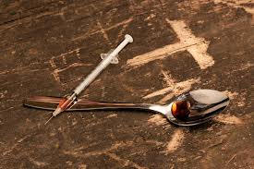
Heroin
Traits and information of Heroin:
Central Nervous System Depressant
Considered to be the most addictive drug
1 in 10 addicts remain sober
Slows breathing which is the major cause of overdose deaths
Heroin can be smoked, snorted or injected.
What the user may look like:
Dry mouth
Flushed skin
Constricted pupils
Extremely lethargic
May ‘nod’ in and out of sleep
Clouded thoughts
Impaired decision making
itching

Slide 25
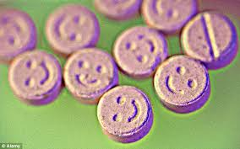
Ecstasy/Molly/MDMA
Traits of MDMA:
Central Nervous System Stimulant
Increases body temperature (sometimes to 106 degrees)
May cause areas of the brain to become inactive due to extreme body temp.
Dehydration
Blurred vision
Difficulty Sleeping
What the user may look like:
Teeth Grinding
Extremely Social
Dilated pupils
Nystagmus (involuntary jitter of eyes)
Impaired speech
Increased perspiration
Drinking lots of water

Slide 26
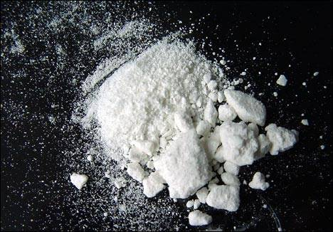
Crack/Cocaine
Traits of Crack/Cocaine
Central Nervous System Stimulant
Insomnia
Loss of appetite
Blurred vision
Vomiting
High anxiety
Constricted blood vessels
Nasal infections
Rapid breathing
Hallucinations
Chest pain
What the user may look like:
Irritable
Dilated pupils
Nose bleeds
Extremely Social
Paranoid
Heavy Perspiration
Violent behavior
Twitching
Sniffles

Slide 27

Prescription Drugs
Popular Rx Stimulants vs Depressants
Dangers of mixing
What is good for one isn’t for all
Myths of Rx drugs
Cost
A very diverse category

Slide 28
Important stuff to remember…
Better to be safe than sorry…call 911
Good Samaritan Act
Alcohol kills and was the first date rape drug.
Alcohol affects the body up to 3 days after your last drink.
Marijuana is also addicting.
Pot has cancer causing stuff in it.
Due to Rx cost rise, illegal drugs are on the rise.
Pills kill too.
Don’t take on a user…call campus safety
Generic Signs of use:
Stimulants:
Large pupils
Very social
Sweating
Tons of energy
Breathing/heart rate is fast
Depressants:
  Small pupils
  Sleepy
  Lack of response
  Lack of motivation
  Breathing/heart rate is slow

Slide 29
For all other stuff…
Find me.
Joshua Parkinson
RMCC 302 Counseling Center
parkinsjm@herkimer.edu
Ext. 8346

Slide 30
Websites for good info.
www.herkimercountyprevention.org
www.oasas.ny.gov
www.samhsa.gov
www.drugabuse.gov
www.niaaa.nih.gov

