Slide 1
Resident Advisor Staff Training
Substance and Alcohol
Program Overview
Wednesday August 21, 2013
10:00am – Noon
RMCC Cogar Gallery
Joshua Parkinson
Substance and Alcohol Prevention Educator

Slide 2
What I do on Campus
First Year Seminar Instructor
RA Trainings
First Year Seminar Addictive Behavior Lectures
Students Against Destructive Decisions Club Advisor
Drugs 101 Educational Series
Help with Alcohol Awareness Events
Alcohol and Other Drugs board member
Substance and Alcohol Awareness Program (SAAP) – Formerly known as SAASy
Intervene
Substance and Alcohol Screenings
Information and Referral on treatment centers for people who display signs of addiction

Slide 3
Alcohol
A more in depth view on alcohol and its effects

Slide 4
Some National Statistics
4 out of 5 students drink alcohol
About Half of the students who report drinking, consume alcohol by binge drinking.
53.4% of students reported missing a class because of alcohol use
33.4% reported performing poorly on a test or project because of alcohol use
48.2% reported experiencing memory loss because of alcohol use
39.7% reported that alcohol use by other students interrupts their studying

Slide 5
More Stats!
Death: 1,825 college students between the ages of 18 and 24 die each year from alcohol-related unintentional injuries.
Assault: More than 690,000 students between the ages of 18 and 24 are assaulted by another student who has been drinking.
Sexual Abuse: More than 97,000 students between the ages of 18 and 24 are victims of alcohol-related sexual assault or date rape.
Injury: 599,000 students between the ages of 18 and 24 receive unintentional injuries while under the influence of alcohol.
Academic Problems: About 25 percent of college students report academic consequences of their drinking including missing class, falling behind, doing poorly on exams or papers, and receiving lower grades overall.
Health Problems/Suicide Attempts: More than 150,000 students develop an alcohol-related health problem and between 1.2 and 1.5 percent of students indicate that they tried to commit suicide within the past year due to drinking or drug use.
Drunk Driving: 2.8 million students between the ages of 18 and 24 reported driving under the influence of alcohol.

Slide 6
Alcohol
Is classified as a Depressant
Is the number one used drug on campus
4 out of 5 college students nationwide consume alcohol
Half of those students binge drink
Is considered a great “Equalizer”
Can affect school and athletic performances up to 3 days after drinking
A leading cause of poor academic performance
A leading cause of motor vehicle deaths among college students

Slide 7
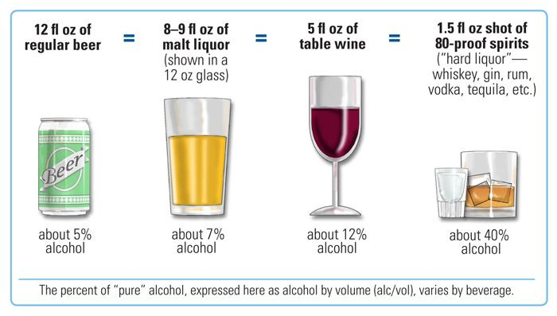
What is a drink?

Slide 8
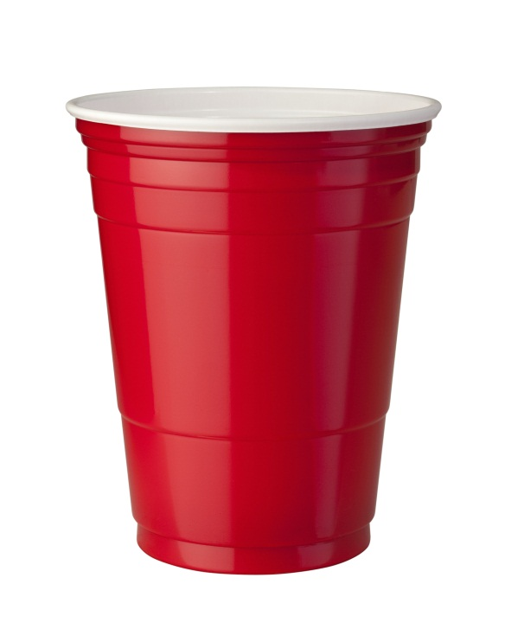


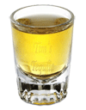
Or in College terms…
12oz Beer
5oz. Wine
1.5oz shot
One cup doesn’t mean one drink.

Slide 9
So what is BAC?
BAC or Blood Alcohol Content is the ratio of alcohol to blood in the body, usually expressed as a percentage. For example .10 percent BAC means one part of alcohol for every thousand parts of blood.
All states set .08 percent BAC as the legal limit for drivers ages 21 and over. Any measureable alcohol is illegal for those under 21.

Slide 10
Factors that influence BAC:
The amount of alcohol consumed.
The rate at which a person drinks.
The person’s weight and body mass
Gender
The amount of food in the stomach
Notes:
#3– the amount of blood that is mixing with the alcohol.
#4 – women have less of the enzyme that metabolizes alcohol, on average they weigh less and they have less blood volume than men, even at equal weight.
#5 – a full stomach slows the pace at which alcohol is absorbed. However, eating before drinking will not prevent high BACs from occurring.

Slide 11
Sobering up takes time…
Time | Activity | BAC
2am | In bed, dizzy and disoriented | .200
3am | Nauseous, unable to sleep | .185
4am | Very restless | .170
5am | Sleeping, but not well | .155
6am | Sleeping | .140
7am | Get up for class – Headache | .125
8am | Drive to school – risk of DUI or worse | .110
9am | In class – trouble focusing on lecture | .095
10am | Judgment still impaired | .080
11am | Mind still foggy, fatigued | .065
Noon | Not hungry, cottonmouth | .050
1pm | In afternoon class – still unfocused | .035
2pm | Head clearing | .020
3pm | Feeling a little better | .005
4pm | Sober at last, but not fully recovered | .000
An evening of heavy drinking follows you into the next day. Alcohol leaves the system at a rate of .015 percent per hour (less than one standard drink per hour). Drinking coffee, taking a shower and other activities have no effect on how fast you sober up. Only time will sober you up.

Slide 12

GPA vs Drinks
“A” Students
“B” Students
This is how each letter grade student drinks per week on average.
“C” Students
“D and F” Students

Slide 13
Short Term Effects
Alcohol

Slide 14
In low doses, alcohol produces:
A relaxing effect
Reduced tension
Lowered inhibitions
Poor concentration
Slow reflexes
Slow reaction time
Reduced coordination
Slower brain activity
Sensations and perceptions that are less clear
In medium doses, alcohol produces:
Slurred speech
Sleepiness
Altered emotions
Poor vision
Sleepiness and disruption of sleeping patterns
Increased urine production
More blood flow to skin surface
Lower core body temperature
In high doses, alcohol produces:
Vomiting
Uncontrolled urination
Uncontrolled defecation
Breathing difficulties
Passing out
Alcohol poisoning
Coma
Possible death

Slide 15
Long Term Effects
Disrupts normal brain development;
Liver damage and cirrhosis of the liver;
Brain cells die, decreasing brain mass;
Stomach and intestinal ulcers and destroyed organs;
Blood pressure increases, causing heart disease, heart attack, or stroke;
Male sperm production decreases;
Lower levels of iron and vitamin B, causing anemia;
Alcoholism;
Fetal alcohol syndrome in unborn children; and
Death.

Slide 16
So…what to look for
When someone has drank too much.

Slide 17
Signs of Alcohol Poisoning
Confusion
Vomiting
Seizures
Slow breathing
(less than eight breaths a minute)
Irregular breathing (a gap of more than 10 seconds between breaths)
Blue-tinged skin or pale skin
Low body temperature (hypothermia)
Passing out (unconsciousness) and can't be awakened
Notes:
It's not necessary to have all these signs and symptoms before you seek help. A person who is unconscious or can't be awakened is at risk of dying.

Slide 18
What to do…
Call 911 or your local emergency number immediately. Never assume that a person will sleep off alcohol poisoning.
Be prepared to provide information. If you know, be sure to tell hospital or emergency personnel the kind and amount of alcohol the person drank, and when.
Don't leave an unconscious person alone. Because alcohol poisoning affects the way your gag reflex works, someone with alcohol poisoning may choke on his or her own vomit and not be able to breathe. While waiting for help, don't try to make the person vomit because he or she could choke.
Help a person who is vomiting. Try to keep him or her sitting up. If the person must lie down, make sure to turn his or her head to the side — this helps prevent choking. Try to keep the person awake to prevent loss of consciousness.
Notes:
It can be difficult to decide if you think someone is drunk enough to warrant medical intervention, but it's best to err on the side of caution. You may worry about the consequences for yourself or your friend or loved one, particularly if you're underage. But the consequences of not getting the right help in time can be far more serious.
Talk about the Good Samaritan Law

Slide 19
Marijuana
A more in depth view on Marijuana and its effects

Slide 20
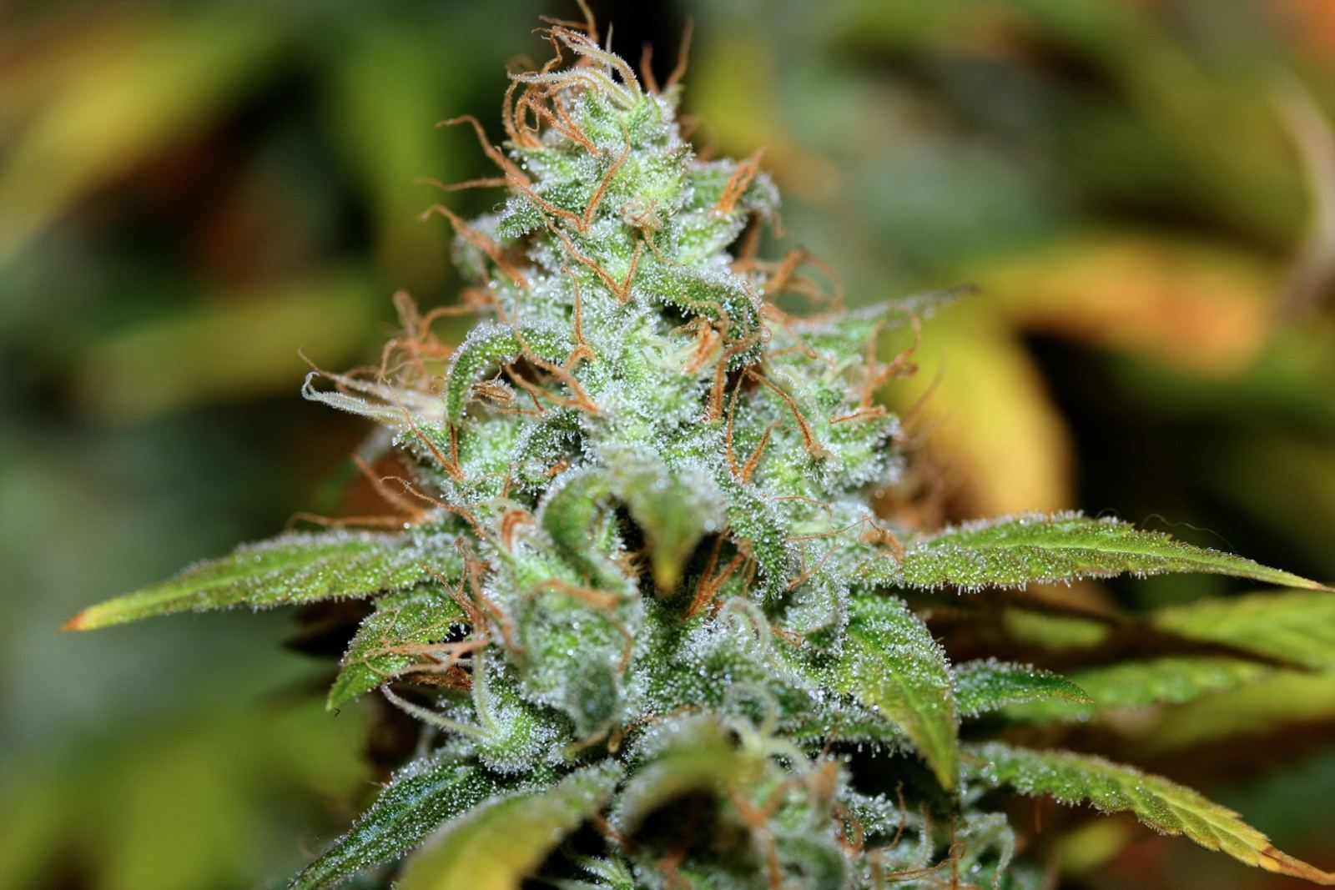
Genus Cannabis 483 Known Compounds
Principal psychoactive constituent: delta 9-tetrahydrocannibinol (THC)

Slide 21
Marijuana safer than Cigarettes?
What do you think?
Why?

Slide 22

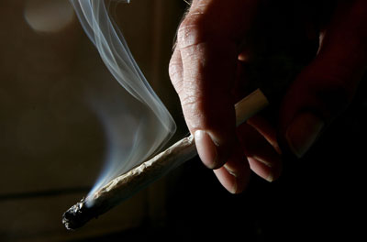
Mercury
PVC Piping
Paint Thinner
Fiber Glass
Rat Poison
Rat Poison
Ammonia
Formaldehyde
Ammonia
Formaldehyde
Urea
Arsenic
Paint Thinner
PVC Piping
Nickel
Nickel
Arsenic
Mercury
Cigarette
Joint
The chemicals don’t get poured in…they are found when the plant is burned and inhaled.
Just because its natural doesn’t mean it “burns” natural

Slide 23

Carcinogens in Marijuana
Definition – a substance capable of causing cancer in living tissue.
Both marijuana and cigarettes contain multiple levels of carcinogens.
acetaldehyde, acetamide, acrylonitrile, 4-aminobiphenyl, arsenic, benz[a]anthracene, benzene, benzo[a]pyrene, benzo[b]fluoranthene, benzo[j]fluoranthene, benzo[k]fluoranthene, benzofuran, 1,3-butadiene, cadmium, carbazole, catechol, chromium (hexavalent compounds), chrysene, dibenz[a,h]anthracene, dibenz[a,i]pyrene, dibenzo[a,e]pyrene, diethylnitrosamine, dimethylnitrosamine, formaldehyde, indeno[1,2,3,-c,d]pyrene, isoprene, lead, mercury, 5-methylchrysene, naphthalene, nickel, pyridine, and quinoline.
This is just Marijuana…
Notes:
Ammonia – Household Cleaner
HCN Hydrogen cyanide - extremely poisonous
Acetaldehyde – believed to be the cause of alcohol hangovers
Acetone – paint thinner
Toluene – paint thinner
Vinyl Chloride – contained in PVC plastic

Slide 24
And you sir, are a pot head!
What to look for and what it does to overall health…

Slide 25

So, what does it look like when someone smokes pot?
Bloodshot eyes
Lack of motivation or ambition for activities that once excited the user.
Slowed speech
Change in performance in school or in the workplace
Averting eye contact or an unsteady gaze
Personal hygiene may begin to suffer as he or she is less concerned with their public appearance.
Drastic change in peer group
Notes:
#4 will begin to decline, coupled with a sense of apathy towards this decline.
#7 – An addict will often abandon peer groups in favor of those who share similar desires and behaviors, namely those engaging in drug use.

Slide 26
Effects on physical health.
Rapid heart rate
Increased blood pressure
Increased rate of breathing
Red eyes
Dry mouth
Increased appetite, or "the munchies“
Slowed reaction time
Marijuana isn’t the “naturally magical” plant everyone thinks that it is.

Slide 27
Effects on mental health.
Persistent:
Impairs memory and learning skills
Sleep impairment
Long Term:
Addiction
Chronic cough, bronchitis
Increased risk of schizophrenia
May increase risk of anxiety, depression, and ‘amotivational’ syndrome.
Acute consequences:
Impairs short-term memory, coordination, balance, attention , judgment, and other cogitative functions.
Psychotic Episodes
Notes:
Persistent – Longer than intoxication

Slide 28
Other substances.
You may or may not see some of these, but its important to cover these at any rate.

Slide 29
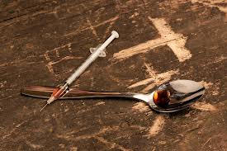
Heroin
Traits and information of Heroin:
Central Nervous System Depressant
Considered to be the most addictive drug
1 in 10 addicts remain sober
Slows breathing which is the major cause of overdose deaths
Heroin can be smoked, snorted or injected.
What the user may look like:
Dry mouth
Flushed skin
Constricted pupils
Extremely lethargic
May ‘nod’ in and out of sleep
Clouded thoughts
Impaired decision making
itching

Slide 30
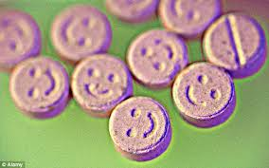
Ecstasy/Molly/MDMA
Traits of MDMA:
Central Nervous System Stimulant
Increases body temperature (sometimes to 106 degrees)
May cause areas of the brain to become inactive due to extreme body temp.
Dehydration
Blurred vision
Difficulty Sleeping
What the user may look like:
Teeth Grinding
Extremely Social
Dilated pupils
Nystagmus (involuntary jitter of eyes)
Impaired speech
Increased perspiration
Drinking lots of water

Slide 31
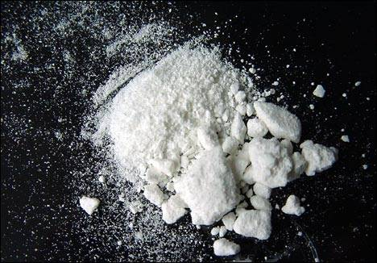
Crack/Cocaine
Traits of Crack/Cocaine
Central Nervous System Stimulant
Insomnia
Loss of appetite
Blurred vision
Vomiting
High anxiety
Constricted blood vessels
Nasal infections
Rapid breathing
Hallucinations
Chest pain
What the user may look like:
Irritable
Dilated pupils
Nose bleeds
Extremely Social
Paranoid
Heavy Perspiration
Violent behavior
Twitching
Sniffles

Slide 32

Prescription Drugs
Popular Rx Stimulants vs Depressants
Dangers of mixing
What is good for one isn’t for all
Myths of Rx drugs
Cost
A very diverse category

Slide 33
Substance and Alcohol Awareness Program
This is what happens when you break the Alcohol and Other Drugs Policy the first time…
Formerly known as SAASy

Slide 34
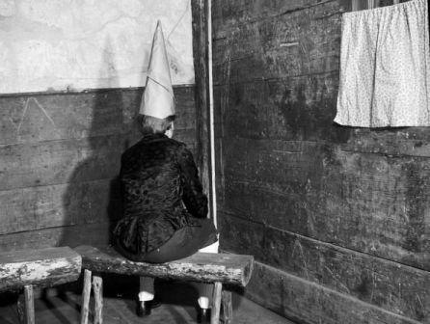
Substance and Alcohol Awareness Program
What does “dry campus” mean?
What is the “AOD” Policy?”
First time offense
How many sessions?
What are the usual SAAP meeting days/times?
Wait…you have requirements?
Who can refer a student for SAAP?

Slide 35
SAAProgram outline
First Session: (Tuesday’s)
Second Session: (Thursday’s)
1.) Introduction: (10min)
What is SAAP?
Why are you here?
What is addiction?
Handouts
1.) Recap from session 1: (5min)
2.) Other Substances and their effects: (20min)
Marijuana
Club Drugs (Cocaine, Meth, Ecstasy etc.)
Gambling
2.) Pre-Test: (10min)
3.) How addiction affects family and friends: (10min)
Warning Signs
Statistics of children born to addicts
Where to get help for a friend
Making better choices.
3.) College and Drinking: (20-25min)
What is BAC?
How it affects grades
Alcohol poisoning
4.) Post-Test and evaluation: (10min)
5.) Wrap-up Discussion (5min)
4.) Wrap up Discussion: (5-10min)

Slide 36
Intervene Program
And…this is what happens when you break the AOD policy twice*
*Exceptions may occur

Slide 37

AOD policy 2nd offense:
Intervene
What is Intervene?
What was before Intervene?
How many sessions now?
How does this work?
Who can make referrals?
When are they scheduled?
What did you mean by “Exceptions” before?
Does this mean you are an addict?
What are the requirements?
What if you skip?
VERY IMPORTANT:
While Intervene is a lot like counseling, it is not counseling. Intervene is a “Brief Intervention” program, not counseling.

Slide 38
Important stuff to remember…
Better to be safe than sorry…call 911
Good Samaritan Act
Alcohol kills and was the first date rape drug.
Alcohol affects the body up to 3 days after your last drink.
Marijuana is also addicting.
Pot has cancer causing stuff in it.
Due to Rx cost rise, illegal drugs are on the rise.
Pills kill too.
Don’t take on a user…call campus safety
Generic Signs of use:
Stimulants:
Large pupils
Very social
Sweating
Tons of energy
Breathing/heart rate is fast
Depressants:
  Small pupils
  Sleepy
  Lack of response
  Lack of motivation
  Breathing/heart rate is slow

Slide 39
For all other stuff…
Find me.
Joshua Parkinson
RMCC 302 Counseling Center
parkinsjm@herkimer.edu
Ext. 8346

Slide 40
Websites for good info.
www.herkimercountyprevention.org
www.oasas.ny.gov
www.samhsa.gov
www.drugabuse.gov
www.niaaa.nih.gov

