Slide 1
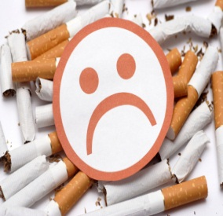
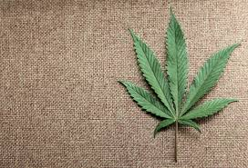
SMOKING AND TOKING
DRUGS 101: PREVENTION ED.
Joshua Parkinson
College Prevention Educator
Herkimer County Catholic Charities

Slide 2
TOBACCO
CIGARETTES, CIGARS, CHEW, DIP

Slide 3
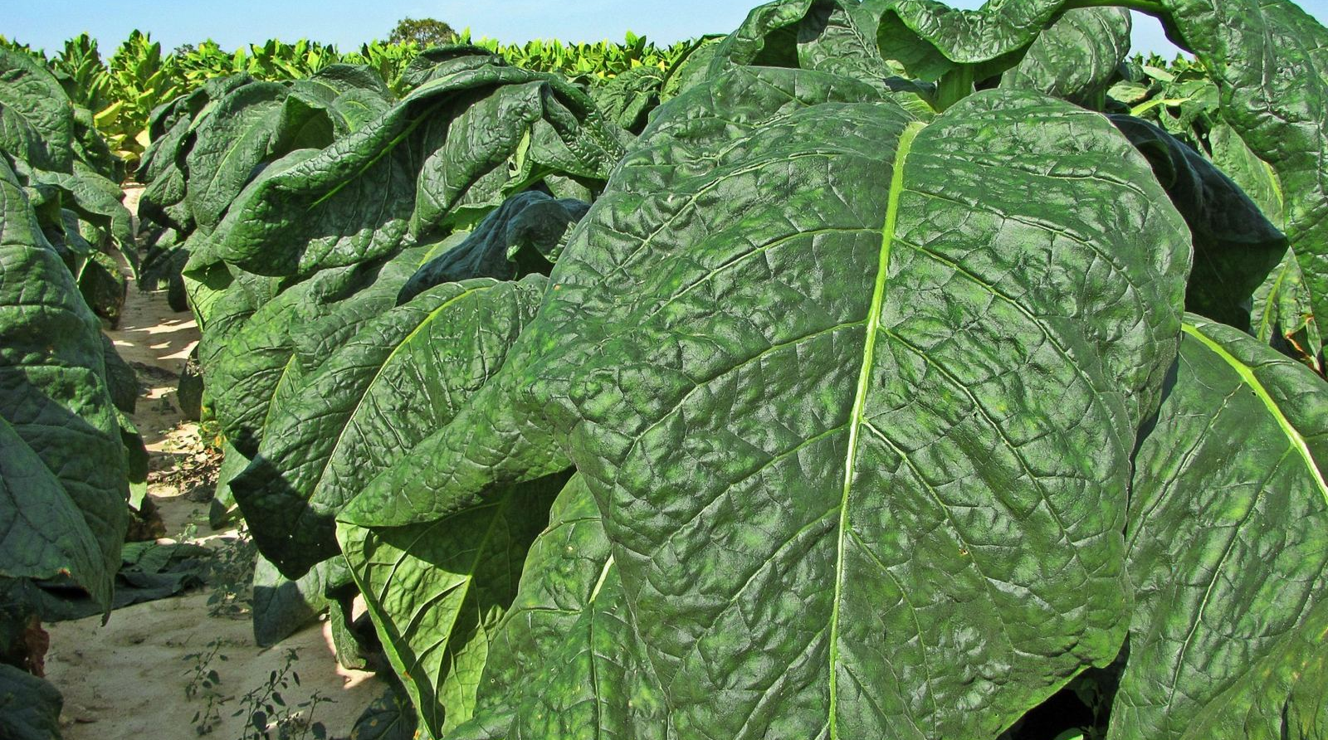
GENUS NICOTIANA (TOBACCO)

Slide 4
WHO SMOKES CIGARETTES?
The following information came directly from www.cancer.org
Caucasian……………………………………………………...........
African Americans…………………………………………………..
Hispanics………………………………………………………………
American Indian/Alaskan Natives……………………………….
Asian Americans…………………………………………………….
Multi racial people………………………………………………….
20.6%
19.4%
12.9%
31.5%
9.9%
27.4%
Approx. 1 in 5 people smoke in the U.S.

Slide 5
COMPARED WITH NON SMOKERS…
Smoking is estimated to increase the risk of:
Coronary heart disease
Stroke
Men developing lung cancer
Women developing lung cancer
Dying from chronic obstructive lung diseases (such as chronic bronchitis and emphysema)
Notes:
by 2 to 4 times
2 to 4 times
23 times
13 times
12 to 13 times

Slide 6
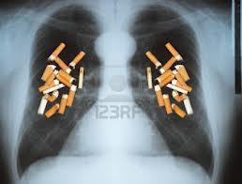
CIGARETTES CAUSE CANCER
Smoking causes the following cancers:
Acute myeloid leukemia
Bladder cancer
Cancer of the cervix
Cancer of the esophagus
Kidney cancer
Cancer of the larynx (voice box)
Lung cancer
Cancer of the oral cavity (mouth)
Pancreatic cancer
Cancer of the pharynx (throat)
Stomach cancer

Slide 7
CIGARETTES CAUSE DEATH
443,000 each year.
HIV, illegal drug use, alcohol use, motor vehicle injuries, suicides, and murder.
90% and 80% Lung Cancer
90% COPD (Chronic obstructive pulmonary disease)

Slide 8
WHAT IS MARIJUANA?
WEED, POT, GANGA, REEFER, GRASS, GREEN

Slide 9
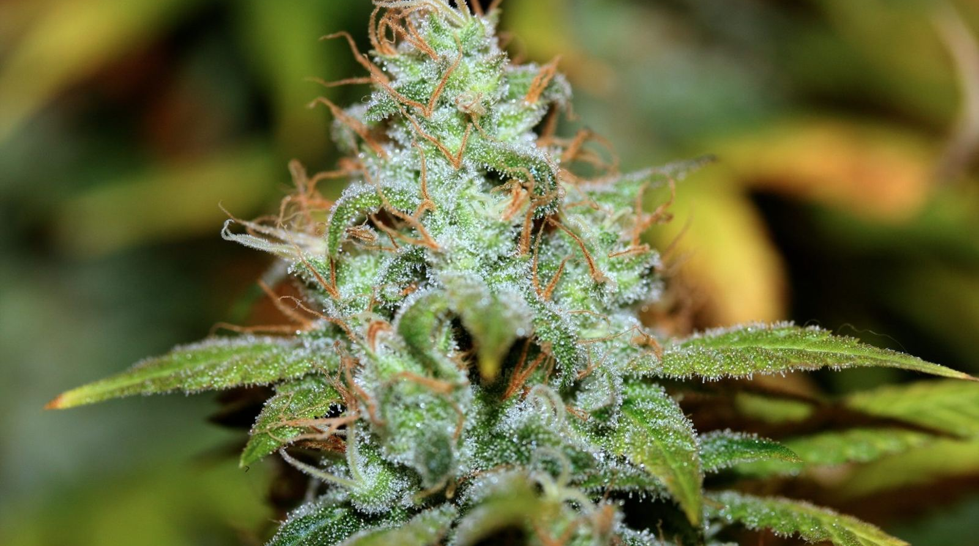
GENUS CANNABIS
483 KNOWN COMPOUNDS
Principal psychoactive constituent: delta 9-tetrahydrocannibinol (THC)

Slide 10
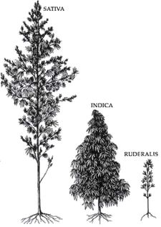
CANNABIS GENUS
Both Sativa and Indica are used to produce the highest amount of THC. These plants are used medicinally and recreationally.
Ruderalis is an auto flowering cannabis and produces a very low amount of THC. This plant isn't typically used for recreation or medicinally.

Slide 11
EFFECTS OF MARIJUANA
PHYSIOLOGICAL
Physiological Effects of Marijuana
The active ingredient in marijuana is THC.
That's short for delta-9-tetrahydrocannabinol.
THC is rapidly absorbed after smoking pot. Within minutes, THC and the other substances in marijuana smoke cause short-term medical effects.
Signs of using marijuana include:
Rapid heart rate
Increased blood pressure
Increased rate of breathing
Red eyes
Dry mouth
Increased appetite, or "the munchies"
Slowed reaction time

Slide 12

EFFECTS OF MARIJUANA
PSYCHOLOGICAL
Other short-term psychological effects of pot include:
Distorted sense of time
Paranoia
Magical or "random" thinking
Short-term memory loss
Anxiety and depression
These psychological signs of using pot also generally ease after a few hours. But residual effects can last for days.
According to the National Institute on Drug Abuse, the main effects of marijuana on mood vary and may include:
Euphoria
Calmness
Anxiety
Paranoia.

Slide 13
RISKS OF USING MARIJUANA
Lung Cancer?!
Testosterone and the little swimmers.
Dudes with boobs?!
Addiction…?
Withdrawal symptoms
Legal Problems
Did you know?
Residents of states with medical marijuana had marijuana abuse/dependence rates almost twice as high as states without such laws.
(Source: “Medical marijuana laws in 50 states: investigating the relationship between state legalization of medical marijuana and marijuana use, abuse and dependence.” Drug and Alcohol Dependence, January 1, 2012.)

Slide 14
WHAT ARE THE LEGAL CONSEQUENCES?
NEW YORK STATE

Slide 15
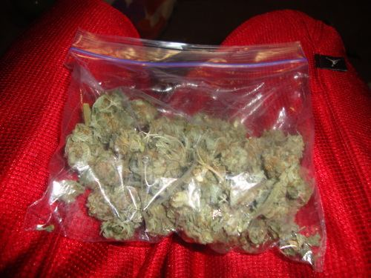
THIS IS APPROX. 1 OZ. OF MARIJUANA
1 gram = $10
28 grams = 1oz.
Approx. $250-$300 per oz.

Slide 16
MARIJUANA AND ITS LEGALITY
POSSESSION AND SALE
Offense | Penalty | Incarceration | Max. Fine
Possession
Less than 25 g (first offense) | Not Classified | N/A | $ 100
Less than 25 g (second offense) | Not Classified | N/A | $ 200
Less than 25 g (third offense) | Not Classified | 15 days | $ 250
25 g - 2 oz. | Misdemeanor | 3 mos.. | $ 250
2 - 8 oz. | Misdemeanor | 1 year | $ 250
8 oz. - 1 lb.. | Felony | 4 years | $ 250
1 - 10 lbs. | Felony | 7 years | $ 250
More than 10 lbs. | Felony | 15 years | $ 250
In public view | Misdemeanor | 90 days | $ 250
Sale
Less than 2 g without profit | Misdemeanor | 3 mos. | $ 500
Less than 25 g | Misdemeanor | 1 year | $ 1,000
25 g - 4 oz. | Felony | 4 years | $ 5,000
4 oz. - 1 lb. | Felony | 7 years | $ 5,000
More 1 lb. | Felony | 15 years | $ 15,000
Using a child to assist | Felony | 4 years | $ 5,000
To a minor | Felony | 7 years | $ 5,000

Slide 17
MARIJUANA AND ITS LEGALITY
TRAFFICKING, CULTIVATION, AND CONCENTRATES
Trafficking
Any amount | Felony | 15* - 25 years | $ 0
* Mandatory minimum sentence
Cultivation
Any amount* | Misdemeanor | 1 year | $ 1,000
* Cultivating marijuana is also possessing marijuana under current case law.
Hash & Concentrates
Possession of up to 1/4 oz. | Misdemeanor | 1 year | $ 1,000
Possession Of 1/4 - 1 oz. | Felony | 7 years | $ 5,000
Possession Of 1 oz. or more | Felony | 15 years | $ 15,000
Sale | Felony | 15 years | $ 15,000

Slide 18
MARIJUANA AND ITS LEGALITY
PARAPHERNALIA, ASSET FORFEITURE AND MISCELLANEOUS
Paraphernalia
Possession or sale of scales or balances for the purpose of weighing or measuring marijuana | misdemeanor | 1 year | $ 0
Subsequent offense | felony | 7 years | $ 5,000
Civil Asset Forfeiture
Property can be seized if convicted of a felony.
Miscellaneous
Mandatory driver's license suspension of 6 mos. for youthful offenders.

Slide 19
WHAT HAPPENED AFTER CALIFORNIA LEGALIZED MARIJUANA?
Since medical marijuana was approved in California, the Los Angeles Police Department reported:
  200% increase in robberies
  52% rise in burglaries
  57% increase in aggravated assaults
  131% increase in burglaries from autos near dispensaries in Los Angeles

Slide 20
SMOKING AND TOKING
WHAT IS THE DIFFERENCE?

Slide 21
BOTH ARE HAZARDOUS
Cigarettes
Marijuana
Has 4,000 Chemicals as opposed to 400 with Marijuana
Has killed more people than HIV, illegal drug use, alcohol use, motor vehicle injuries, suicides, and murder combined.
Is addictive – Physiological
Is 90% of the cause of Lung Cancer.
Is currently lethal
Inhale more smoke (two-thirds larger puff volume)
Inhale the smoke deeper into the lungs (one-third greater depth of inhalation)
Hold the smoke in the lungs for longer time periods (up to four times longer).
Can cause impaired driving.
Is addictive – Psychological
Habitual Smokers tend to smoke less than Cigarette Smokers
Is currently illegal

Slide 22
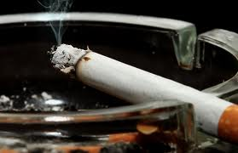
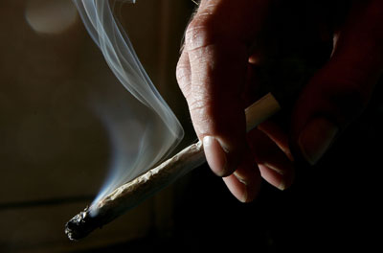
THE CHEMICALS DON’T GET POURED IN…THEY ARE FOUND WHEN THE PLANT IS BURNED AND INHALED.
Mercury
Paint Thinner
PVC Piping
Rat Poison
Fiber Glass
Rat Poison
Formaldehyde
Ammonia
Ammonia
Formaldehyde
Urea
PVC Piping
Paint Thinner
Nickel
Arsenic
Arsenic
Nickel
Mercury
JUST BECAUSE ITS NATURAL DOESN’T MEAN IT “BURNS” NATURAL

Slide 23
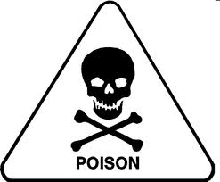
BOTH CIGARETTES AND MARIJUANA SHARE THESE INGREDIENTS WHEN BURNED
Carbon Monoxide
Carbon Dioxide
Ammonia – Household Cleaner
HCN – Hydrogen cyanide extremely poisonous
Cyanogen (CN)2
Isoprene
Acetaldehyde – believed to be the cause of alcohol hangovers
Acetone – paint thinner
Acrolein
Acetonitrile benezene
Benezene
Toluene – paint thinner
Vinyl Chloride – contained in PVC plastic
Dimethylnitrosamine
Methyletheylnitrosamine
Cited from the Institute of Medicine

Slide 24
CARCINOGENS?
Definition – a substance capable of causing cancer in living tissue.
Both marijuana and cigarettes contain multiple levels of carcinogens.
Marijuana has:
acetaldehyde, acetamide, acrylonitrile, 4-aminobiphenyl, arsenic, benz[a]anthracene, benzene, benzo[a]pyrene, benzo[b]fluoranthene, benzo[j]fluoranthene, benzo[k]fluoranthene, benzofuran, 1,3-butadiene, cadmium, carbazole, catechol, chromium (hexavalent compounds), chrysene, dibenz[a,h]anthracene, dibenz[a,i]pyrene, dibenzo[a,e]pyrene, diethylnitrosamine, dimethylnitrosamine, formaldehyde, indeno[1,2,3,-c,d]pyrene, isoprene, lead, mercury, 5-methylchrysene, naphthalene, nickel, pyridine, and quinoline.

Slide 25
CARCINOGENS CONTINUED
CIGARETTES
Acetaldehyde
Acrylonitrile
4-Aminobiphenyl
o-Anisidine hydrochloride
Arsenic
Benzene
Beryllium
1,3-Butadiene
Cadmium
1,1-Dimethylhydrazine
Ethylene oxide
Formaldehyde
Furan
Heterocyclic amines
Hydrazine
Isoprene
Lead
2-Naphthylamine
Nitromethane
N-Nitrosodi-n-butylamine
N-Nitrosodiethanolamine
N-Nitrosodiethylamine
N-Nitrosodimethylamine
N-Nitrosodi-n-propylamine
4-(N-Nitrosomethylamino)-1-(3-pyridyl)-1-butanone
N-Nitrosonornicotine
N-Nitrosopiperidine
N-Nitrosopyrrolidine
N-Nitrososarcosine
Polonium-210
Polycyclic aromatic hydrocarbons
o-Toluidine
Vinyl chloride

Slide 26
SO…WHERE ARE THINGS GOING?
WELL…

Slide 27

LEGISLATION IN NEW YORK
MARIJUANA
Senate Bill
SB 1682
"Legalizes the possession, manufacture, sale, administration, delivery, dispensing and distribution of [up to 8 oz of] marijuana in connection with medical use thereof for certified patients... permits registered organizations to sell, administer, deliver, etc. marijuana to certified patients or the caregiver of a certified patient for certified medical use..."
Senate Bill
SB 4406
"Legalizes the possession, acquisition, use, delivery, transfer, transport or administration of marihuana by a certified patient or designated caregiver for a certified medical use..."
All bills were referred to the health committee.
Assembly Bill
AB 6357
"Legalizes the possession, acquisition, use, delivery, transfer, transport or administration of marihuana by a certified patient or designated caregiver for a certified medical use..."
It’s only a matter of time!

Slide 28
TIMES ARE CHANGING.
Medical Marijuana increases DWI: A 2009 National Highway Traffic Safety Administration report found that more people are driving on weekend nights under the influence of marijuana (8.3%) than alcohol (2.2%). (Source: National Highway Traffic Safety Administration Report, 2009.)
Less people smoke cigarettes today than did 10 years ago. (was 1in 4, now its 1 in 5).
Medical marijuana had gained steam from many advocates, political figures and celebrities.
Anti smoking adds continue to work well with the younger population, regardless how graphic they are. What was once appealing to children (Camel, Marlboro Cowboy) have been virtually erased by victims of tobacco cancer.

Slide 29
THINGS TO REMEMBER…
Marijuana is addictive.
Marijuana is harmful to your mental and physical health.
Tobacco has killed more people than HIV, illegal drug use, alcohol use, motor vehicle injuries, suicides, and murder combined.
90% of the time…lung cancer is caused by cigarette smoking.
The chemicals you hear about in cigarettes and marijuana are a by product of burning it. Some one doesn’t just pour a bunch of “Decon Rat Poison” into a huge vat and say “lets have people smoke it!”
With dispensaries introduced to California…Crime went through the roof.

Slide 30

WHERE TO GET HELP
Beacon Center of Herkimer
210 South Main Street
Herkimer, New York 13350
Telephone: (315) 717-0189
Beacon Center of Utica
1508 Genesee Street
Utica, New York 13501
Telephone: (315) 366-4100
Insight House
500 Whitesboro St
Utica, New York 13502
(315) 724-5168
Conifer Park
79 Glenridge Rd.
Glenville, New York 12302
1-800-989-6446

Slide 31
FOR MORE INFORMATION
Herkimer County Prevention Council
A program of Catholic Charities
61 West Street
Ilion New York, 13357
(315)894-9917
www.herkimercountyprevention.org
Some other websites:
www.oasas.ny.gov
www.samhsa.gov
www.drugabuse.gov
www.niaaa.nih.gov

