Slide 1
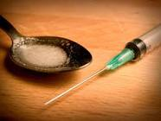
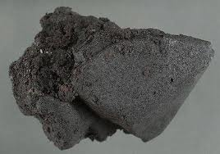
All about:
Heroin
Drugs 101: Prevention Ed.
a brief educational series detailing various substances
Joshua Parkinson
Herkimer County Catholic Charities
College Prevention Educator

Slide 2
Why is heroin use on the rise?
According to the Substance Abuse and Mental Health Services Administration (SAMHSA), first time use of heroin has increased 80 percent among 12 to 17 year-olds since 2002. More troublingly, young people are dying in greater numbers. In 1999, the number of fatal overdoses in young people between the ages of 15 and 24 was 198. Ten years later, it had risen to 510.
Notes:
According to the Substance Abuse and Mental Health Services administration (SAMHSA), initiations to heroin have increased 80 percent among 12 to 17 year-olds since 2002. More troublingly, young people are dying in greater numbers, too. In 1999, the number of fatal overdoses in young people between 15 and 24 was 198. Ten years later, it had risen to 510.

Slide 3
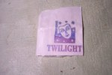
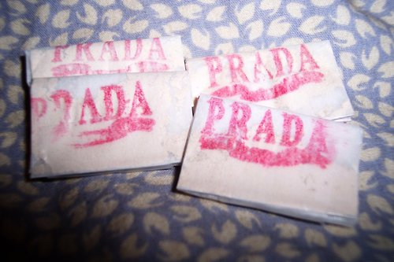
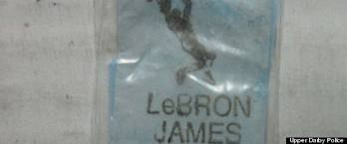
What was once lost, has now been found…
Prescription opioid painkillers abuse has been on the rise. Most teens are familiar with drugs like Oxycontin and Vicodin, which makes the effects of Heroin less “scary”.
Some heroin dealers have stamped their heroin containers with a “twilight” cartoon photo of Robert Pattinson, making the contents seem less dangerous and more appealing to a younger generation.
The more you know fact #1:
Fatal prescription drug overdoses surpassed car crashes as the leading cause of accidental death in 2007, according to the Department of Health.
Because the cost of black market prescription drugs have increased greatly (up to $60 per pill), young people are turning to a cheaper solution; Heroin which can be bought for approximately $5-$25 per bag.
Notes:
Prescription opioid painkillers abuse has been on the rise. Most teens are familiar with drugs like OxyContin and Vicodin, which makes the effects of Heroin less “scary”.
Some heroin dealers have stamped their heroin containers with a “twilight” cartoon photo of Robert Pattinson, making the contents seem less dangerous and more appealing to a younger generation.
Because the cost of black market prescription drugs have increased greatly (up to $60 per pill), young people are turning to a cheaper solution, Heroin which can be bought for approximately $5-$25 per bag.
**Note that the leading cause of death in 2007 has changed to drug overdose. **

Slide 4
Where does Heroin come from?
Short answer:
The Opium Poppy, which is an annual herb native to Southeastern Europe and western Asia.
Long answer?

Slide 5
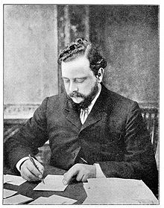
History of Heroin
(diacetylmophine)
1874 - In hopes of finding a non addictive alternative to morphine, C. R. Adler Wright had been experimenting the effects of adding various acids with morphine.
By boiling anhydrous morphine alkaloid with acetic anhydride over a stove for several hours, he produced a much more potent, form of morphine. The new version is called diacetylmorphine or morphine diacetate.
The newly synthesized compound was then sent to F. M. Pierce of Owens College for analysis. Pierce wrote…
Notes:
Anhydrous – (ann-high-drus)
Acetic anhydride – (ah-see-tick ann-high-dryed)
Diacetylmorphine – (die-ah-seat-uhl-more-feen)
Morphine diacetate – (more-feen die-ah-seh-tate)

Slide 6
Pierce’s Statement to Wright
“Doses of the anhydrous hydrochloride of [alpha]- and ß-diacetyl-morphines, tetracetyl-morphine, and diacetyl-codeine were subcutaneously injected into young dogs and rabbits, the quantities used in each instance being equivalent to 0.050 gram of anhydrous morphine hydrochloride, with the following general results.
No great amount of difference between the first three substances was noticeable, great prostration, fear, and sleepiness speedily following the administration, the eyes being sensitive, and pupils dilated, considerable salivation being produced in dogs, and slight tendency to vomiting in some cases, but no actual emesis.
Respiration was at first quickened, but subsequently reduced, and the heart's action was diminished, and rendered irregular. Marked want of coordinating power over the muscular movements, and loss of power in the pelvis and hind limbs, together with a diminution of temperature.”
- F. M. Pierce
Notes:
Most of what this means is that in comparision to what was on the market at the time, this new drug didn’t have significant importance nor did it represent a huge change in the way of pain killing.
After testing, Pierce sent the results back to Wright. Wright in turn decided to put further development of heroin on hold.
23 years later…

Slide 7

Wrights heroin development was halted due to “lack of progress”.
23 years later…

Slide 8
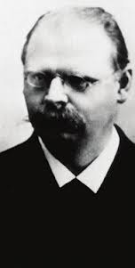
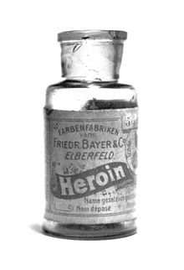
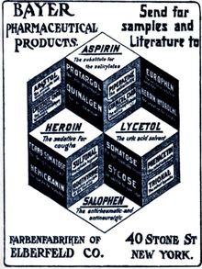
Marketing Heroin
1898 - Heinrich Dreser, a chemist with Bayer Labs, convinced Bayer to market Heroin as an analgesic and sedative for coughs.
Analgesic - painkiller
Bayer also marketed the drug as a cure for morphine addiction before it was discovered that the drug rapidly metabolizes into morphine…ught ohhh
Notes:
Heinrich Dreser instructed his subordinate Felix Hoffmann, to further Wright’s work and acetylate morphine with the objective of making codeine.
Codeine is pharmacologically similar to morphine but much less potent and much less addictive.
Instead of making Codeine, Felix Hoffmann created an acetylated form of morphine that is one and a half to two times greater in potency than morphine itself.
After which they marketed this Wonder Drug as a “cure for morphine addiction”. However, they did so too quickly…
They later found out that Heroin was rapidly metabolizing back into morphine thus causing addicts to remain addicted and people who weren't addicted before to experience one of the world’s most addictive drug.

Slide 9
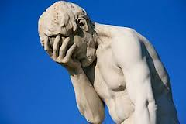

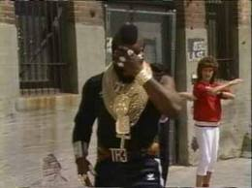




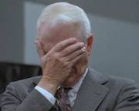
Marketing blunder?!…
And because diacetylmorphine rapidly metabolizes into morphine within the body, it is actually a faster acting form of morphine…And just as addictive.
Bayer removed the product from shelves.

Slide 10
Moving more quickly…
1914 – The Harrison Narcotics Tax Act was passed to control the sale and distribution of diacetylmorphine. This allowed the drug to be prescribed and sold for medical purposes.
1924 – The U.S. Congress banned its sale, importation or manufacture. Classified as a Schedule 1 Substance.
1925 – The Health Committee of the League of Nations banned diacetylmorphine. Hydromorphone and dihydromorphine were the first designer drugs (analogues) related to morphine to arise.
1930 – The Committee banned diacetylmorphine analogues with no therapeutic advantage over drugs already in use. This marks the first major legislation of this type.
…this marked the end of Medicinal Heroin
Notes:
**Note the time from creation to the time it was scheduled and classified as illegal.
1874 – Created
1898 – Refined
1924 – Made Schedule 1
1930 – BANNED.
56 years to become illegal
Schedule I drugs are not considered legitimate for any medical use, and examples include heroin, LSD, MDMA (Ecstasy) and marijuana.
Schedule II drugs are considered to have a strong potential for abuse or addiction but that also have legitimate medical use, and examples include opium, morphine, methamphetamine and cocaine.
Schedule III drugs are considered to have less potential for abuse or addiction than Schedule I or II drugs and have a useful medical purpose. Included are anabolic steroids, pentobarbital and hydrocodone (Vicodin).
Schedule IV drugs are considered to be a medically useful category of drugs that have less potential for abuse or addiction than those of Schedules I, II, and III. Included are drugs that might often be known by their brand names, including Xanax, Darvocet and Ambien.
Schedule V drugs are a medically useful category of drugs that have less potential for abuse or addiction than those of Schedules I through IV. One example is the cough medicine Robitussin.

Slide 11

So, what do we know Heroin as?
The more you know fact # 2:
Junkie:
During the early 1920s a number of New York addicts supported themselves by collecting scrap metal from industrial dumps, so earning the label ‘junkies’.

Slide 12
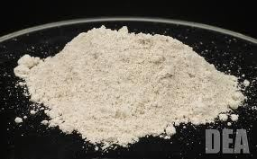
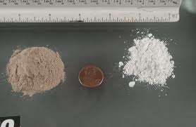
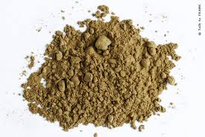
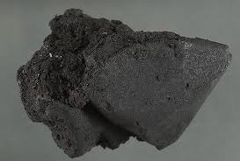
What is Heroin?
Heroin is a central nervous system depressant or “downer”. It affects the brains pleasure systems. Heroin affects the brains ability to perceive pain.
Heroin is often white to dark brown in color. It’s a powder or tar-like substance (Black Tar Heroin) and has various routes of administration.
Black Tar Heroin

Slide 13
Street names…
Dragon
Dope
Heron
Herone
Hero
Hera
H
Big H
White
China White
White Nurse
White Lady
White Horse
Boy
He
Black
Black Tar
Black Pearl
Black Stuff
Black Eagle
Brown
Brown Crystal
Brown Sugar
Brown Tape
Brown Rhine
White Girl
White Stuff
Chiba
Chiva
Chieva
Mexican Brown
Mexican Mud
Mexican Horse
Junk
Tar
Snowball
Snow
White Boy
Smack
Scag
Scat
Sack
Skunk
Number 3
Number 4
Number 8

Slide 14
Uses of Heroin (diacetylmorphine)
Given via subcutaneous, intramuscular, intrathecal or intravenous.
Fatty layer of the skin
Directly into the muscle
Spinal Canal
Directly into the Vein
Smoking
Inhaling
Snorting
Medical
Acute Pain – Severe Physical Trauma
Chronic Pain – Terminal Illnesses
Recreation
Relaxation
Intense Euphoria
Prescription
Addiction Treatment (other countries)

Slide 15
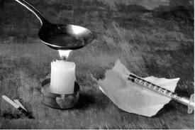
Routes of Administration
Smoking: Onset 10-15 minutes
  Smoked in a water pipe or standard pipe also mixed in with marijuana joint or blunts or regular cigarette tobacco.
Sniffed: Onset 10-15 minutes
  Often inhaled as smoke through a straw or snorted as powder through the nose (much like Cocaine users).
Injection (vein): Onset 7-8 Seconds
Injection (muscle): Onset 5-8 minutes
Injection (subcutaneous): Onset 5-8 minutes
Most users choose to snort or smoke heroin instead of injecting it when starting out. As the heroin addiction progresses, smoking and snorting heroin becomes obsolete due to the fact that injecting delivers the strongest highs with less of an “onset period”.

Slide 16
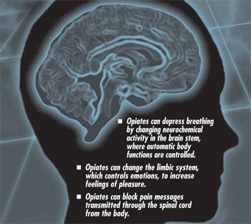
Short term effects:
*These are the most prominent short term effects.
"Rush“
Depressed respiration
Clouded mental functioning
Nausea and vomiting
Suppression of pain
Spontaneous abortion
Notes:
Soon after injection (or inhalation), heroin crosses the blood-brain barrier. In the brain, heroin is converted to morphine and binds rapidly to opioid receptors. Abusers typically report feeling a surge of pleasurable sensation, a "rush."
The intensity of the rush is a function of how much drug is taken and how rapidly the drug enters the brain and binds to the natural opioid receptors. Heroin is particularly addictive because it enters the brain so rapidly.
With heroin, the rush is usually accompanied by a warm flushing of the skin, dry mouth, and a heavy feeling in the extremities, which may be accompanied by nausea, vomiting, and severe itching.
After the initial effects, abusers usually will be drowsy for several hours. Mental function is clouded by heroin's effect on the central nervous system. Cardiac function slows. Breathing is also severely slowed, and sometimes, in the case of overdose, to the point of death.
Heroin overdose is a particular risk on the street, where the amount and purity of the drug cannot be accurately known. Increasingly, a drug known as naloxone is being used (even by users on the street) to treat overdose.

Slide 17
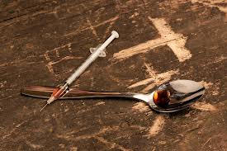
Long term effects:
Addiction
Infectious diseases (HIV/AIDS, Hepatitis B/C)
Collapsed veins
Bacterial infections
Abscesses
Infection of heart lining and valves
Arthritis and other associated problems
*Overdose/Death can be long term or short term. Some people overdose and die even after their first use.

Slide 18
Important to remember…
Heroin has become cheaper than a pack of cigarettes.
Because the “high” is similar to OxyContin and other prescription medication, people are more accepting and willing to taking drastic measures to achieve the same “high” (using needles).
It’s not just injecting the drug that causes overdoses. Smoking or snorting can be just as dangerous. Especially if you mix heroin with other depressants or drugs (heroin laced marijuana, drinking alcohol accompanied with the use of Heroin).

Slide 19

Where to get help…treatment
Beacon Center of Herkimer
210 South Main Street
Herkimer, New York 13350
Telephone: (315) 717-0189
Insight House
500 Whitesboro St
Utica, New York 13502
(315) 724-5168
Beacon Center of Utica
1508 Genesee Street
Utica, New York 13501
Telephone: (315) 366-4100
Conifer Park
79 Glenridge Rd.
Glenville, New York 12302
1-800-989-6446

Slide 20
For more information
Herkimer County Prevention Council
A program of Catholic Charities
61 West Street
Ilion New York, 13357
(315)894-9917
www.herkimercountyprevention.org
Some other websites:
www.oasas.ny.gov
www.samhsa.gov
www.drugabuse.gov
www.justice.gov/dea

Slide 21
Next up…
Alcohol, Athletics and Academics focuses on the effects of alcohol on the college student in their studies and/or athletics. Many students feel that alcohol and partying is part of the College experience, however many don’t understand how partying affects their Collegiate performance(s).
March 5th, 2013
12:30pm – 1:20pm
RMCC 283
Register by February 28th, 2013
Refreshments provided.

Slide 22
Work Cited:
http://web.archive.org/web/20040606103721/http://adhpage.dilaudid.net/heroin.html
^ Excerpt from Pierce to Wright
http://www.opioids.com/poppy.html
Where the opium poppy is from
http://www.historytoday.com/ian-scott/heroin-hundred-year-habit
Junkie stuff and other history stuff
http://www.salon.com/2012/08/31/teen_heroin_use_on_the_rise/
Samhsa numbers on slide 2
http://www.justice.gov/dea/druginfo/ds.shtml
Drug Scheduling
http://www.drugabuse.gov
Effects and various other information.
http://www.google.com
All of the images used in this powerpoint.

