Slide 1
Alcohol, Athletics and Academics
Drugs 101: Prevention Ed.
a brief educational series detailing various substances
Joshua Parkinson
College Prevention Educator
Herkimer County Catholic Charities

Slide 2

Drinking at College:
Alcohol, Athletics and Academics
According to a study from the National Institute on Alcohol Abuse and Alcoholism; 25 percent of college students report academic problems caused by alcohol use, such as earning lower grades, doing poorly on exams or papers, missing class, and falling behind.
Notes:
According to a study from the National Institute on Alcohol Abuse and Alcoholism; 25 percent of college students report academic problems caused by alcohol use, such as earning lower grades, doing poorly on exams or papers, missing class, and falling behind.

Slide 3
Alcohol is:
Alcohol, Athletics and Academics
Classified as a depressant
A powerful diuretic
One of the leading causes of property damage on college campuses
One of the leading causes of poor academic performances
One of the leading causes of motor vehicle deaths among college students

Slide 4
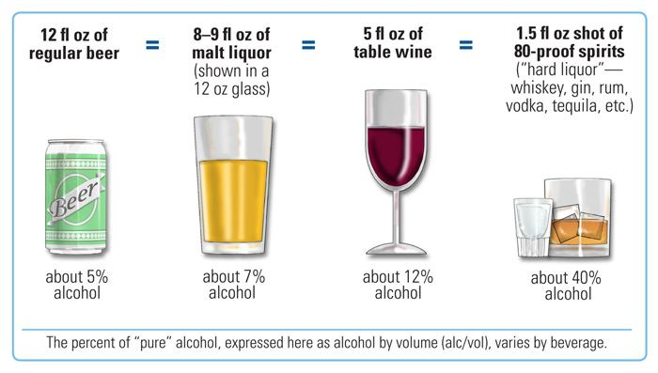
What is a standard drink?!
Alcohol, Athletics and Academics

Slide 5
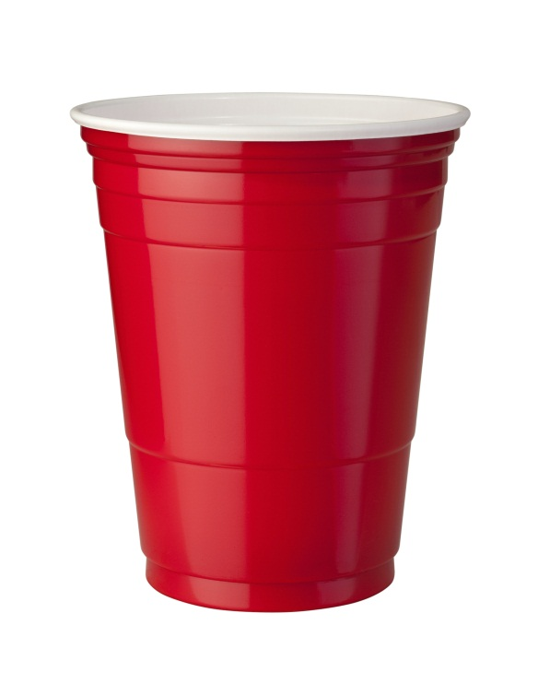
Translated for college…
Alcohol, Athletics and Academics
12oz Beer
5oz. Wine
1.5oz shot
One cup doesn’t mean one drink.

Slide 6
Degrees of drinking
Alcohol, Athletics and Academics
Moderate drinking, which is defined as 1 drink for women and 2 drinks for men.
Drinking in moderation can have some health benefits such as;
Reduced Risk of Heart Disease
Reduced Risk of Diabetes
Reduced Risk of Dementia

Slide 7
Degrees of drinking cont…
Alcohol, Athletics and Academics
Binge Drinking which is defined as 4 or more drinks for women and 5 or more for men.
Binge drinking can become extremely harmful to over all health.
Car crashes
Alcohol Poisoning
Injuries
Death

Slide 8

Alcohol and Athletics:
Alcohol, Athletics and Academics
Muscle Development and Recovery
Ability to Learn New Plays and Strategies
Nutrition and Endurance

Slide 9
How Alcohol Affects Muscle Development and Recovery
Alcohol, Athletics and Academics
Short-term alcohol use can impede muscle growth.
Long-term alcohol use diminish protein synthesis. Decreasing muscle build up.
Decrease the secretion of Human Growth Hormones (HGH) by as much as 70%.
Alters the ability to produce adenosine triphosphate (ATP). ATP provides the fuel necessary for your muscles to contract.
Dehydrates your body causing slower recuperation times and slows the healing process your body needs after an injury.
Notes:
Few athletes realize that consuming alcohol after a workout, practice, or competition can cancel out any physiological gains you may have received from the activity. Not only does long-term alcohol use diminish protein synthesis resulting in a decrease in muscle build-up, but even short-term alcohol use can impede muscle growth.
In order to build bigger and stronger muscles, your body needs sleep to repair itself after a workout. Because of alcohol’s effect on sleep, your body is deprived of a chemical called human growth hormone or HGH. HGH is part of the normal muscle building and repair process and the body’s way of telling itself your muscle needs to grow bigger and stronger. Alcohol however can decrease the secretion of HGH by as much as 70%.
When alcohol is in your body, it triggers the production of a substance in your liver that is directly toxic to testosterone. Testosterone is essential for the development and recovery of your muscles. As alcohol is absorbed through your stomach and small intestine and into your cells, it can disrupt the water balance in muscle cells, altering their ability to produce aden o seen triphosphate (ATP), which is your muscles’ source of energy. ATP provides the fuel necessary for your muscles to contract.
Speeding the recovery of sore muscles and injuries is integral to optimal performance. On occasion when an athlete is injured and can’t perform they may see this as an opportunity to use alcohol. Alcohol is a toxin that travels through your bloodstream to every organ and tissue in your body, causing dehydration and slowing your body’s ability to heal itself.

Slide 10
How Alcohol Affects Your Ability to Learn New Plays and Strategies
Alcohol, Athletics and Academics
When alcohol is in your system your brain’s ability to learn and store information is inhibited due to compromising the hippocampus.
Disrupts the sequence and duration of normal sleep, reducing your brain’s ability to retain information.
Sleep deprivation also suppresses normal hormonal levels decreasing oxygen availability and consumption decreasing endurance.
Consuming five or more alcoholic beverages in one night can affect brain and body activities for up to three days
Two consecutive nights of drinking five or more alcoholic beverages can affect brain and body activities for up to five days.
Attention span is shorter for periods up to forty-eight hours after drinking.
Even small amounts of alcohol BAC of .03 can persist for a substantial period of time after the acute effects of alcohol impairment disappear.
Notes:
For most athletes, preparation, learning plays and strategies is essential to peak performance. Use of alcohol can have negative effects on this process. When alcohol is in your system your brain’s ability to learn and store information is inhibited due to compromising the hippocampus, a structure deep in the brain vital to the formation of new memories. Forming memories is a very complex process and many of your memories are solidified when you are not thinking of the information, such as during sleep.
Alcohol effects your sleep cycle by disrupting the sequence and duration of normal sleep, reducing your brain’s ability to retain information. For example, the REM stage of sleep is compromised after a night of drinking, which is vital to memory. The sleep deprivation also suppresses normal hormonal levels decreasing oxygen availability and consumption decreasing endurance.

Slide 11
How Alcohol Affects Nutrition and Endurance
Alcohol, Athletics and Academics
The body treats alcohol as fat, converting alcohol sugars into fatty acids.
Alcohol is oxidized by dehydrogenase it produces an elevation of NADH reducing the production of ATP (which is the muscles source of energy), resulting in lack of energy and loss of endurance.
Women have very little of the enzyme dehydrogenase, which is the reason why females experience higher intoxication even when drinking the same amount with a male their same size.
Notes:
Ever feel tired and unmotivated after a night of drinking or even a day or two later? Alcohol holds very little nutritional value. The relatively high calories in alcohol are not available to your muscles. The body treats alcohol as fat, converting alcohol sugars into fatty acids. When alcohol is oxidized by dehydrogenase (the enzyme that breaks down alcohol) it produces an elevation of NADH reducing the production of ATP (which is the muscles source of energy), resulting in lack of energy and loss of endurance. Because women have very little of the enzyme dehydrogenase, females experience the primary effect of higher intoxication even when drinking the same amount with a male their same size.
Alcohol use inhibits absorption of important nutrients such as thiamin, vitamin B12, folic acid, and zinc. What do you need these nutrients for?
Thiamin (B1) is involved in the metabolism of proteins and fat, the formation of hemoglobin, and it metabolizes carbohydrates.
Vitamin B12 is essential to maintain healthy red blood and nerve cells.
Folic acid is part of a coenzyme involved in the formation of new cells.
Zinc is essential to your energy metabolic processes. The depletion of zinc can have an effect on reducing endurance.

Slide 12
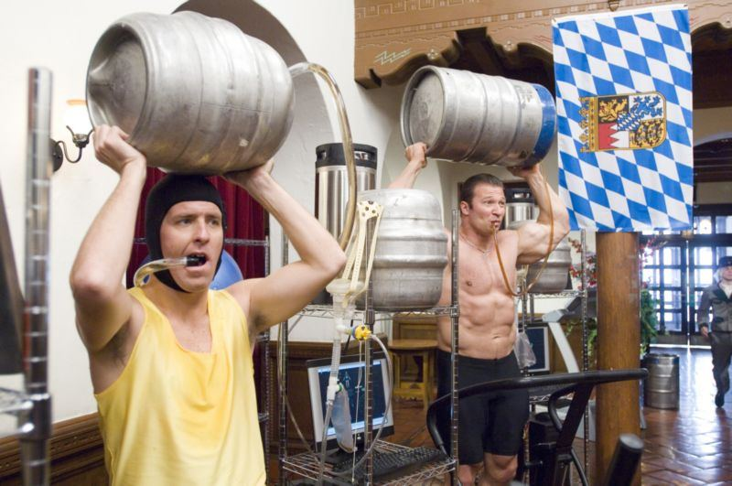
Alcohol, Athletics and Academics
Alcohol use inhibits absorption of important nutrients such as thiamin, vitamin B12, folic acid, and zinc. What do you need these nutrients for?
Thiamin (B1) is involved in the metabolism of proteins and fat, the formation of hemoglobin, and it metabolizes carbohydrates.
Vitamin B12 is essential to maintain healthy red blood and nerve cells.
Folic acid is part of a coenzyme involved in the formation of new cells.
Zinc is essential to your energy metabolic processes. The depletion of zinc can have an effect on reducing endurance

Slide 13

Alcohol, Athletics and Academics

Slide 14


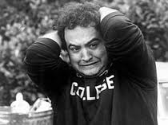
Alcohol and Academics
Alcohol, Athletics and Academics
1 in 4 college students report academic consequences of their drinking, including missing class, falling behind, doing poorly on exams or papers, and receiving lower grades overall.

Slide 15
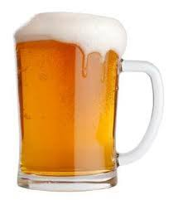
GPA drink-down
Alcohol, Athletics and Academics
This is how each letter grade student drinks per week on average.
“A” Students
“B” Students
“C” Students
“D and F” Students

Slide 16

Some National statistics
Alcohol, Athletics and Academics
4 out of 5 students drink alcohol
About Half of the students who report drinking, consume alcohol by binge drinking.
53.4% of students reported missing a class because of alcohol use
33.4% reported performing poorly on a test or project because of alcohol use
48.2% reported experiencing memory loss because of alcohol use
39.7% reported that alcohol use by other students interrupts their studying

Slide 17
Stats continued…
Alcohol, Athletics and Academics
Death: 1,825 college students between the ages of 18 and 24 die each year from alcohol-related unintentional injuries.
Assault: More than 690,000 students between the ages of 18 and 24 are assaulted by another student who has been drinking.
Sexual Abuse: More than 97,000 students between the ages of 18 and 24 are victims of alcohol-related sexual assault or date rape.
Injury: 599,000 students between the ages of 18 and 24 receive unintentional injuries while under the influence of alcohol.
Academic Problems: About 25 percent of college students report academic consequences of their drinking including missing class, falling behind, doing poorly on exams or papers, and receiving lower grades overall.
Health Problems/Suicide Attempts: More than 150,000 students develop an alcohol-related health problem and between 1.2 and 1.5 percent of students indicate that they tried to commit suicide within the past year due to drinking or drug use.
Drunk Driving: 2.8 million students between the ages of 18 and 24 reported driving under the influence of alcohol.

Slide 18
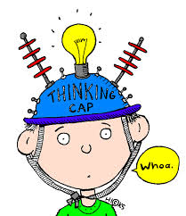
Abstract thinking and Alcohol
Alcohol, Athletics and Academics
Alcohol affects a person's abstract thinking, which is a style of thinking that forms concepts and ideas which are then understood and later applied in problem solving.
Abstract thinking is required to solve puzzles, understand a person's motivations, figure out story problems, and excel academically. A person who drinks to the point of intoxication may experience impaired abstract thinking.
Depending how much you drink, these effects can last for weeks.

Slide 19
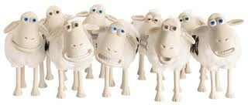
Alcohol and Sleep
Alcohol, Athletics and Academics
Alcohol changes the normal rhythms of sleep by increasing the amount of time people spend in "deep sleep," but also decreasing the amount of time people spend in REM sleep by disrupting sleep during this stage, which is necessary for memory, concentration and motor skills.
REM sleep is very important for the college student because this is the time the brain actively stores learned materials and builds concentration for the next day.
So…studying and then partying is only going to waste your time.
Because your brain “digests” that information during your REM sleep.

Slide 20
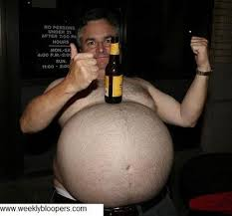

Alcohol and your body
Alcohol, Athletics and Academics
This is what happens when you make chicken nuggets at 3am
Your body can only take care of 1 drink per hour…

Slide 21
Brain and Heart
Alcohol, Athletics and Academics
Brain:
Alcohol interferes with the brain’s communication pathways, and can affect the way the brain looks and works. These disruptions can change mood and behavior, and make it harder to think clearly and move with coordination.
Heart:
Drinking a lot over a long time or too much on a single occasion can damage the heart, causing problems including:
  Cardiomyopathy – Stretching and drooping of heart muscle
  Arrhythmias – Irregular heart beat
  Stroke
  High blood pressure

Slide 22
Liver and Pancreas
Alcohol, Athletics and Academics
Liver:
Heavy drinking takes a toll on the liver, and can lead to a variety of problems and liver inflammations including:
  Steatosis, or fatty liver
  Alcoholic hepatitis
  Fibrosis – excess fibrous connective tissue in an organ
  Cirrhosis – Liver failure
Pancreas:
Alcohol causes the pancreas to produce toxic substances that can eventually lead to pancreatitis, a dangerous inflammation and swelling of the blood vessels in the pancreas that prevents proper digestion.

Slide 23
Cancer and Immune System
Alcohol, Athletics and Academics
Cancer:
Drinking too much alcohol can increase your risk of developing certain cancers, including cancers of the:
  Mouth
  Esophagus
  Throat
  Liver
  Breast
Immune System:
Drinking too much can weaken your immune system, making your body a much easier target for disease. Chronic drinkers are more liable to contract diseases like pneumonia and tuberculosis than people who do not drink too much. Drinking a lot on a single occasion slows your body’s ability to ward off infections – even up to 24 hours after getting drunk.

Slide 24
Short term and Long term effects of alcohol.
Alcohol, Athletics and Academics

Slide 25
Short term effects
Alcohol, Athletics and Academics
In low doses, alcohol produces:
A relaxing effect
Reduced tension
Lowered inhibitions
Poor concentration
Slow reflexes
Slow reaction time
Reduced coordination
Slower brain activity
Sensations and perceptions that are less clear
In medium doses, alcohol produces:
Slurred speech
Sleepiness
Altered emotions
Poor vision
Sleepiness and disruption of sleeping patterns
Increased urine production
More blood flow to skin surface
Lower core body temperature
In high doses, alcohol produces:
Vomiting
Uncontrolled urination
Uncontrolled defecation
Breathing difficulties
Passing out
Alcohol poisoning
Coma
Possible death

Slide 26
Long term effects
Alcohol, Athletics and Academics
Disrupts normal brain development;
Liver damage and cirrhosis of the liver;
Brain cells die, decreasing brain mass;
Stomach and intestinal ulcers and destroyed organs;
Blood pressure increases, causing heart disease, heart attack, or stroke;
Male sperm production decreases;
Lower levels of iron and vitamin B, causing anemia;
Alcoholism;
Death; and
Fetal alcohol syndrome in unborn children.

Slide 27
In summary
Alcohol consumption works against students and athletes.
Celebrating a win with alcohol is supporting a loss for your next game.
Drinking alcohol when recuperating from an injury will prolong the time needed to return to the field.
Drinking causes many problems with the student including DWI, assault, property damage, missed classes, poor attention span, and overall GPA.
Drinking disrupts REM sleep which is important for studying, concentration and abstract thinking.

Slide 28

Where to get help…treatment
Alcohol, Athletics and Academics
Beacon Center of Herkimer
210 South Main Street
Herkimer, New York 13350
Telephone: (315) 717-0189
Beacon Center of Utica
1508 Genesee Street
Utica, New York 13501
Telephone: (315) 366-4100
Insight House
500 Whitesboro St
Utica, New York 13502
(315) 724-5168
Conifer Park
79 Glenridge Rd.
Glenville, New York 12302
1-800-989-6446

Slide 29
For more information…
Alcohol, Athletics and Academics
Herkimer County Prevention Council
A program of Catholic Charities
61 West Street
Ilion New York, 13357
(315)894-9917
www.herkimercountyprevention.org
Some other websites:
www.oasas.ny.gov
www.samhsa.gov
www.drugabuse.gov
www.niaaa.nih.gov

Slide 30
Next up…
Alcohol, Athletics and Academics
Smoking and Toking will focus on cigarettes and marijuana and its impact on overall health. Many students refuse to think that marijuana is as detrimental as cigarettes. In this session students will understand the myths of marijuana, the parallels with cigarettes and the current climate of its “social status”.
April 23, 2013
Time : 12:30pm – 1:20pm
Room: CC-283
Register by:
Thursday April 18th, 2013
Refreshments Provided

